Slide 1


WORKSHOP ON FINANCING FOR RENEWABLE ENERGY IN SMALL ISLAND DEVELOPING STATES (SIDS), NADI, FIJI: 1-3 DECEMBER 2016
Session 3: SIDS update
Status of RE project development and deployment status in Pacific Islands – opportunities and challenges
Solomone FIFITA, Deputy Director (Energy), SPC

Slide 2
OPPORTUNITIES AND CHALLENGES
RE Project Development Status
RE Deployment Status

Slide 3
RE Project Development Status
1984 - Lomé II Pacific Regional Energy Programme PREP
to promote RE and reduce dependence on imported fuels.
6.19 million Euro
22 hardware projects were designed as pilot and demonstration projects
About 50% of the initial projects were cancelled for a variety of reasons.
Redesigned in 1988 and completed in 1995
Donor driven and technology driven

Slide 4
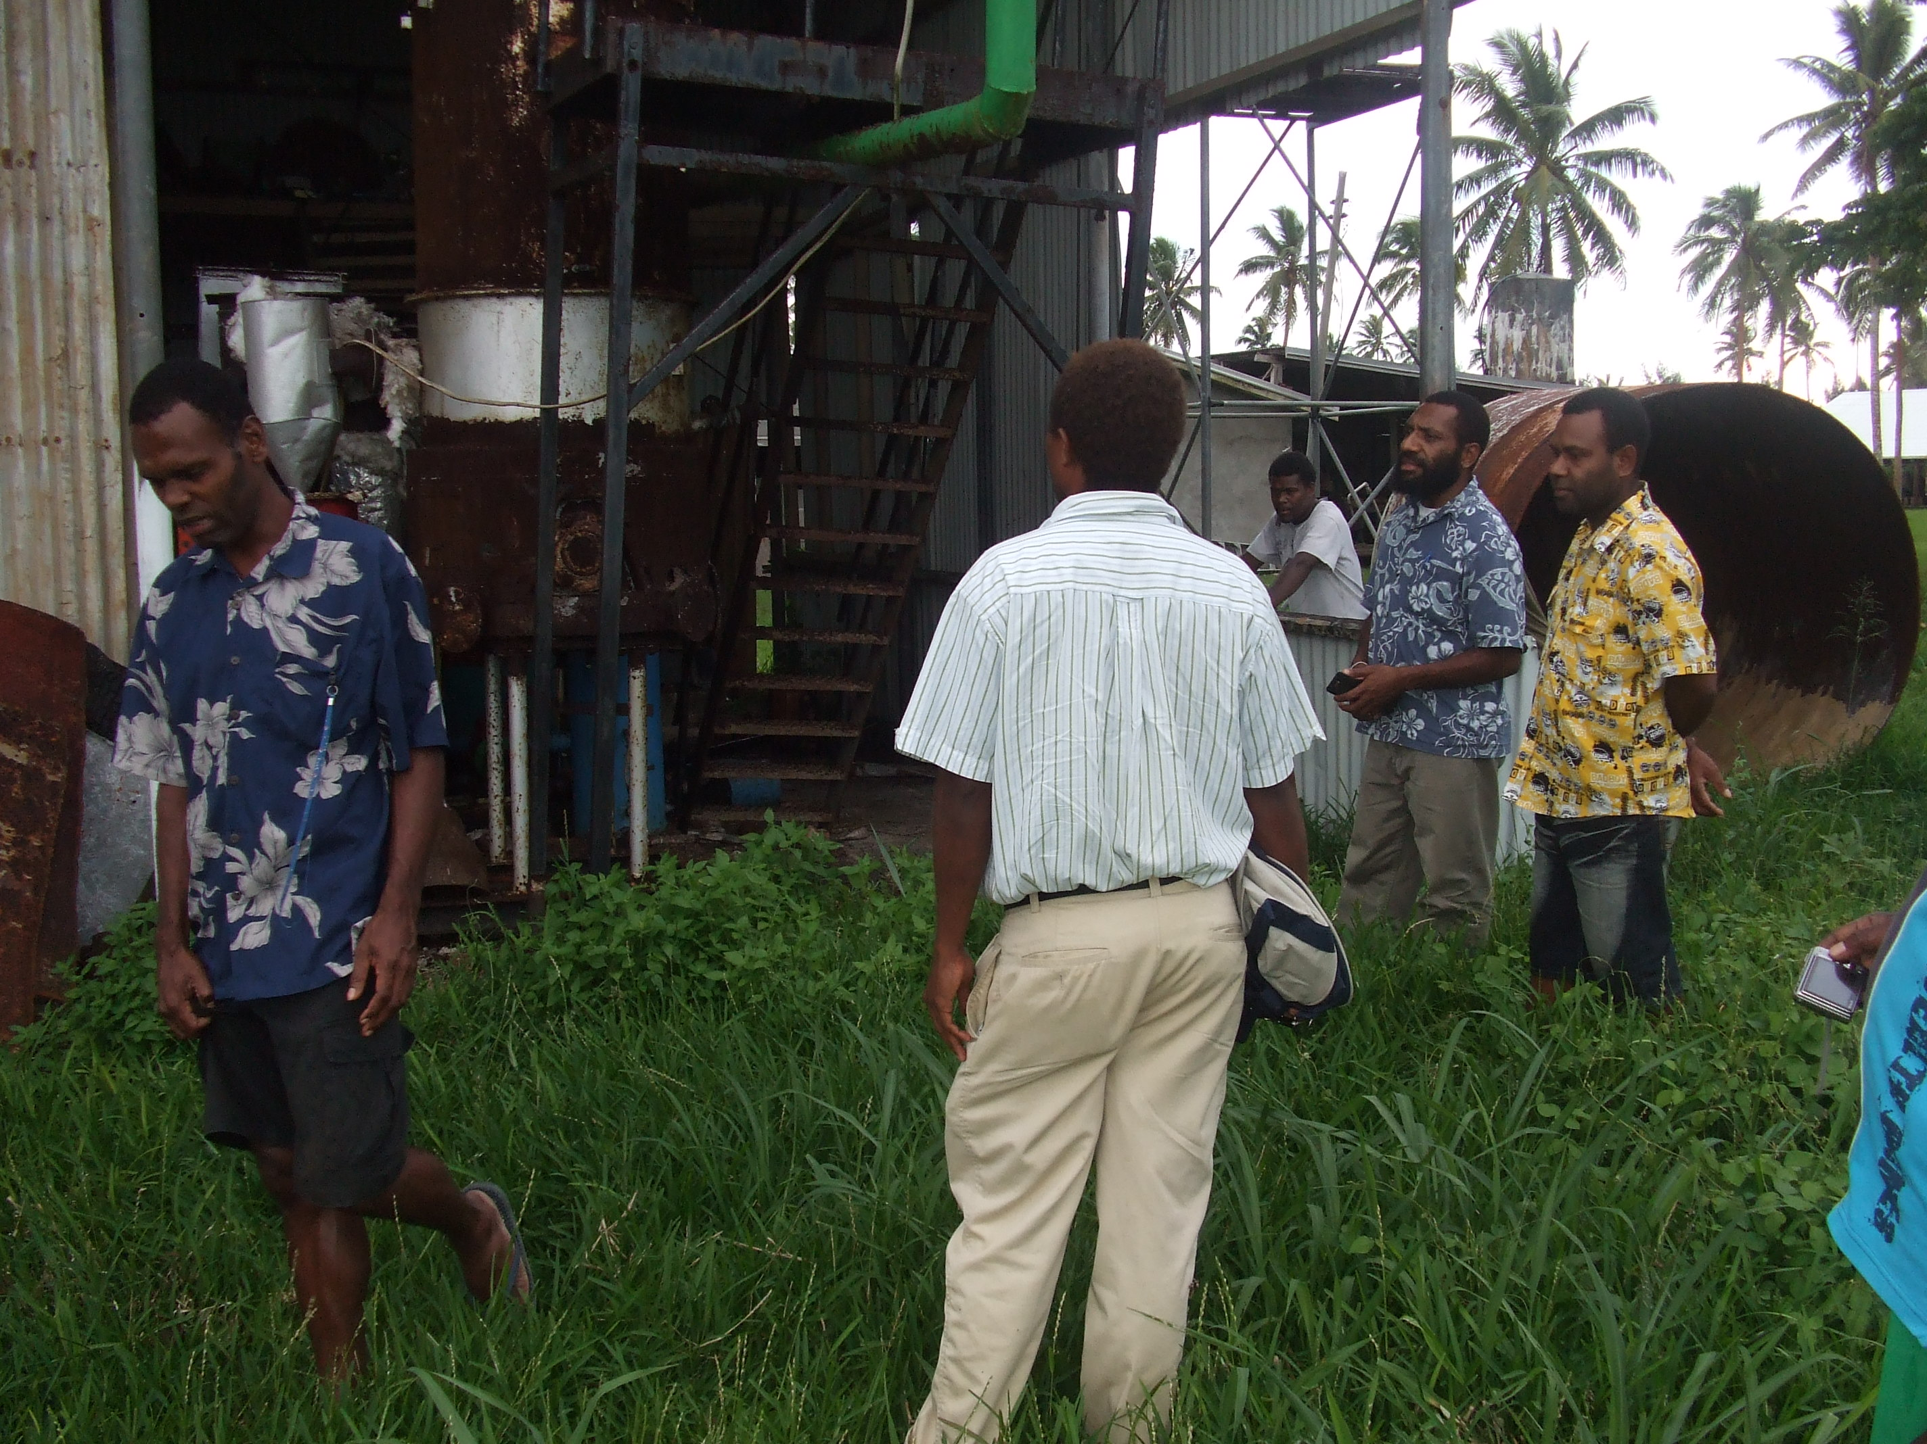
Vanuatu Gasifier

Slide 5
RE Project Development Status
1993 – Lome III PREP
Power Utility reforms
GIS Asset Management
Training Coordinator
EE
Completed in 1998

Slide 6
RE Project Development Status
2000 - Pacific Renewable Energy France-Australia Common Endeavour (PREFACE)
Wind power in the Cook Is
Solar PV in Tonga
Solar PV in schools and health centres in Vanuatu
Completed in 2003

Slide 7
RE Project Development Status
2004 – GEF funded Pacific Islands Renewable Energy Project (PIREP)
Pacific Regional Energy Assessment - An Assessment of the Key Energy Issues, Barriers to the Development of Renewable Energy to Mitigate Climate Change, and Capacity Development Needs for Removing the Barriers
Completed in 2006

Slide 8
RE Project Development Status
2004 - Danish-funded Pacific Islands Energy Policy and Strategic Action Plan (PIESAP) project
Completed in 2008

Slide 9
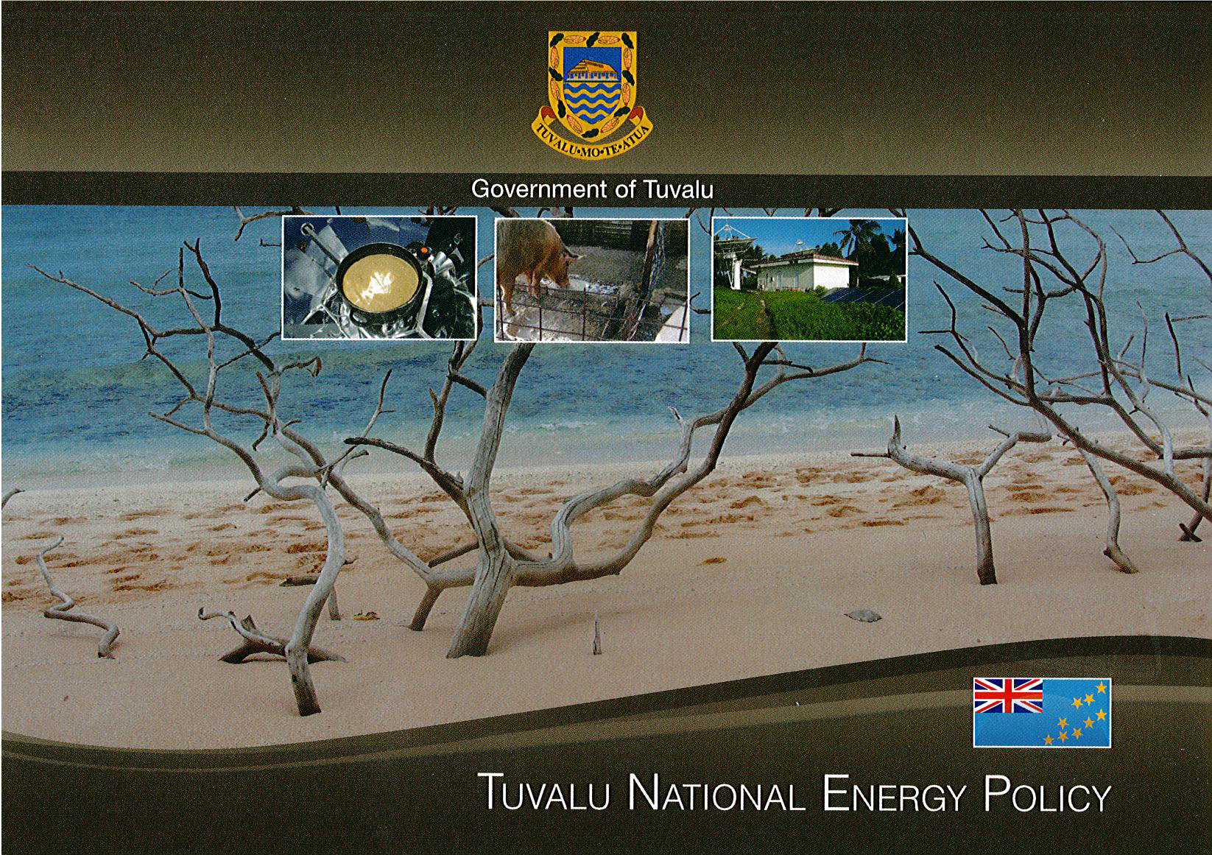
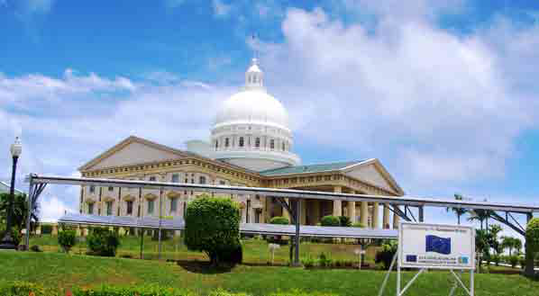
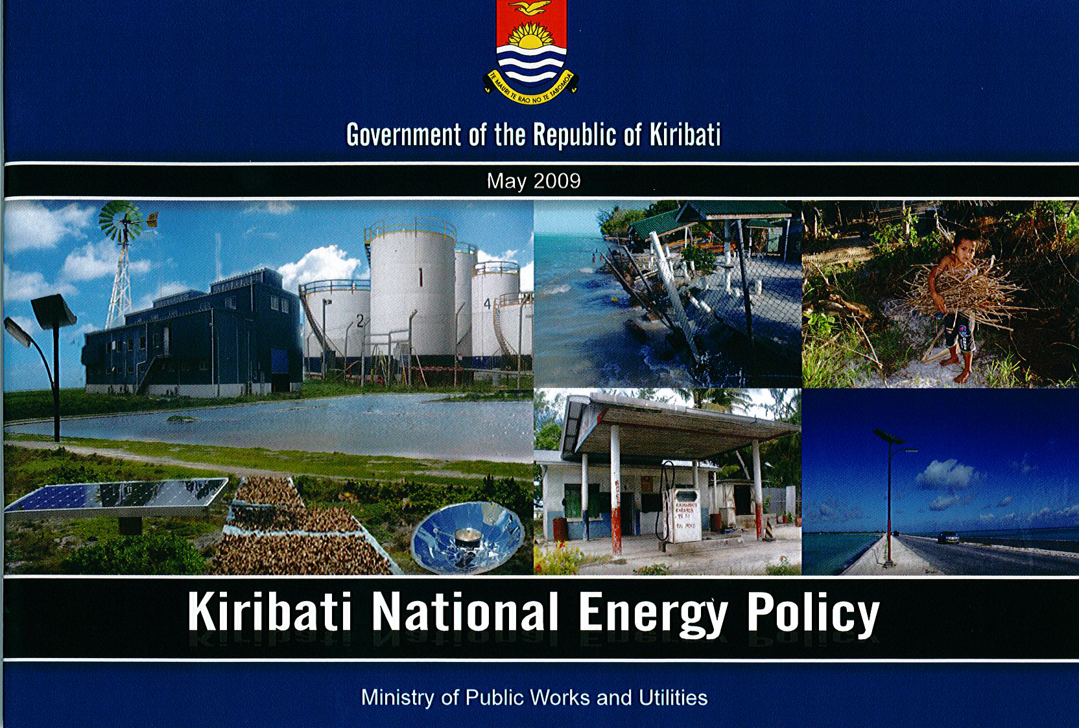
Palau National Energy Policy

Slide 10
RE Project Development Status
2007 - GEF-funded Pacific Islands Greenhouse Gas Abatement through Renewable Energy Project (PIGGAREP).
Barrier removal
PIGGAREP Plus
Completed in 2014
Others include the ADMIRE, SEDREA & SEFP

Slide 11
RE Project Development Status
2008 – EESLI by IUCN
Italian and Austrian-funded project
Managing the Ecosystem and Livelihood Implications of Energy Policies in the Pacific Island States
On-going
PICs develop their funding proposals

Slide 12
RE Project Development Status
2010 – North REP by the EU
Completed in 2014

Slide 13

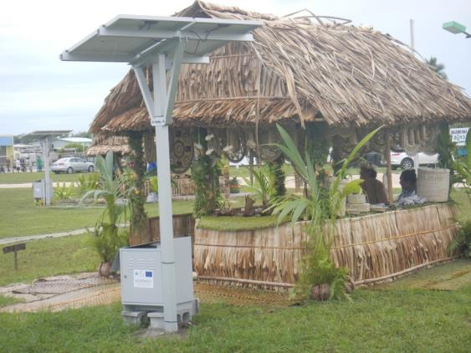
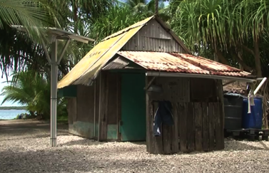
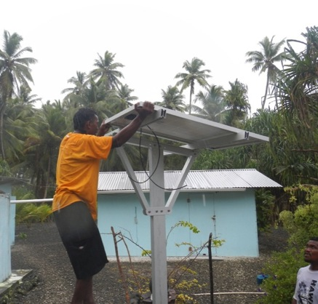
Hardware – RE
Solar PV Home Systems

Slide 14
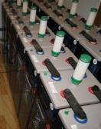
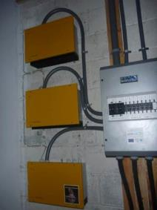
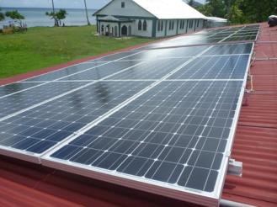
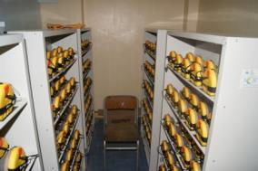
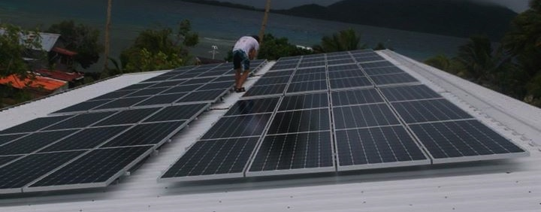
Hardware – RE
Solar PV Stand-alone Systems at public facilities

Slide 15

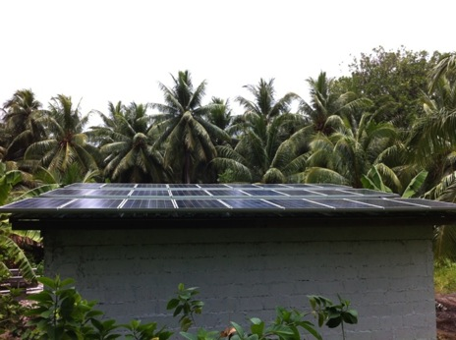
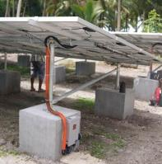
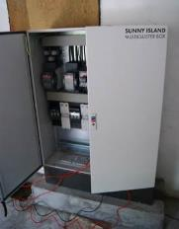
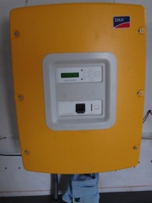
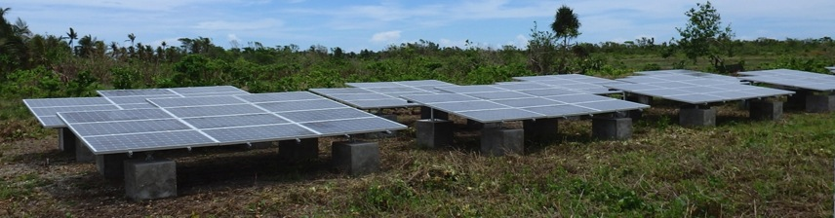
Hardware – RE
Solar PV micro-grids

Slide 16
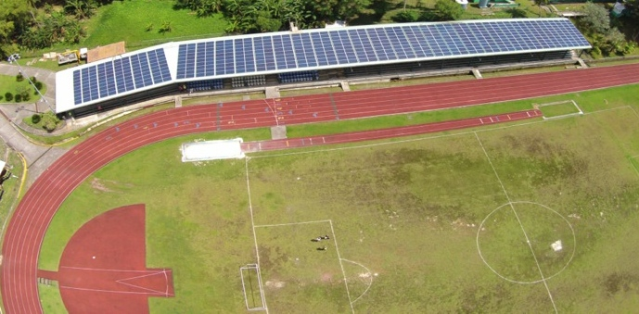
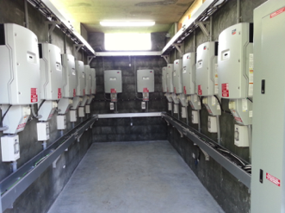
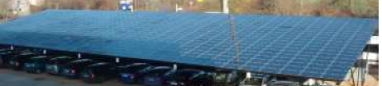
Hardware – RE
Grid connected systems – solar PV

Slide 17
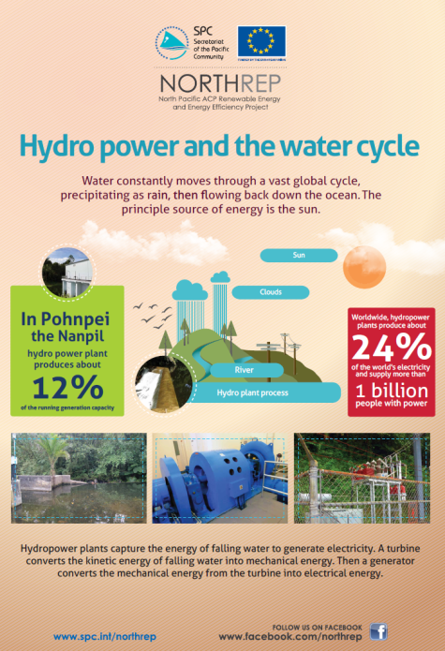
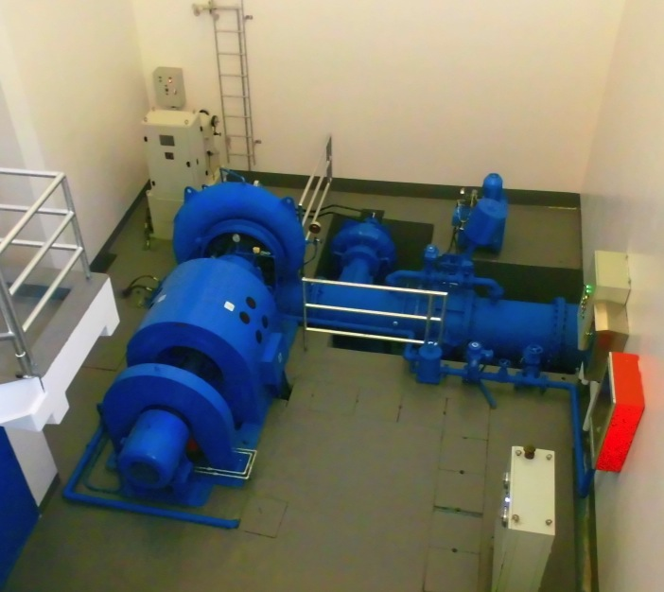
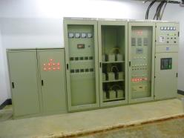
Hardware – RE
Grid connected systems - hydropower

Slide 18
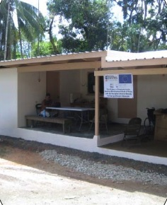

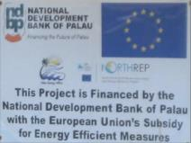
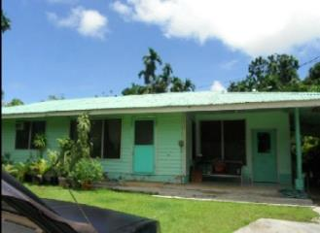
Hardware – EE
Retrofitting of buildings through the Development Bank

Slide 19
RE Project Development Status
2010 – PEC Fund
USD 4 million per country
Various hardware installations
Completed in 2016
PICs developed their respective proposals

Slide 20
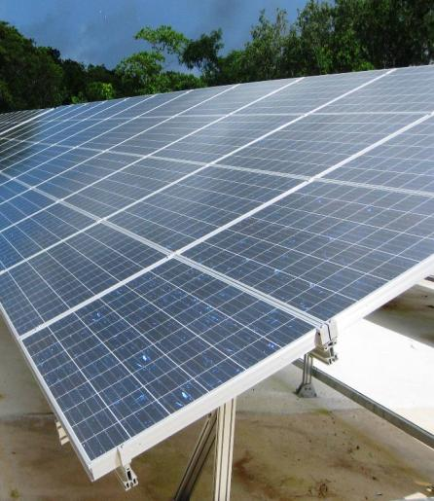
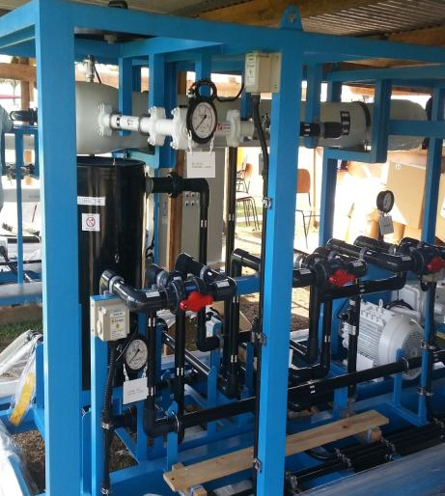
PACIFIC ENVIRONMENT COMMUNITY FUND
PACIFIC ENVIRONMENT COMMUNITY FUND
Notes:
Turning now to the Pacific Environment Community Fund or PEC as many of us have come to know and refer to it, was launched by Japan and FIC Leaders at PALM 5 in 2009. Japan provided ¥6.8billion or US$66m to support projects in solar power generation, sea water desalination or a combination of both.
Each FIC was provided with an allocation of US$4million, for projects to be implemented at national and, or local levels. PIFS coordinates, administers and monitors the Fund.

Slide 21
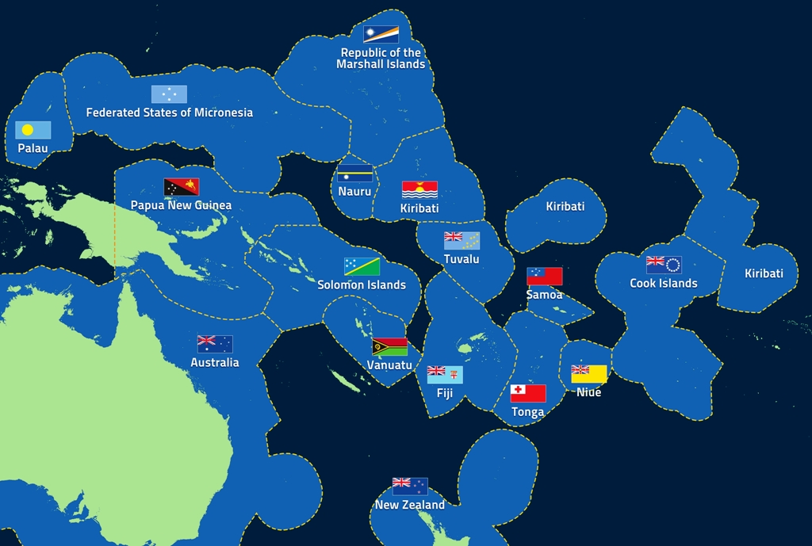
Solar Electrification
Notes:
8 FICs are doing solar projects
These take the form of either grid connected solar systems, mini-grid solar systems for rural areas and outer islands, off grid solar systems and solar home systems
Of the 8 FICs, 5 selected grid and mini grid connected solar systems; with one country selecting off-grid solar systems; and two choosing to install 3000 solar home systems.

Slide 22
Water Desalination
Notes:
7 countries decided to implement projects in sea water desalination
These desalination plants are providing an alternative supply of safe drinking water. The desalination plants are either fixed or portable and are used for supplementing current water supply or for use during times of emergencies or disaster events such as droughts.
Of the 7 FICs, 6 are using a hybrid method of combining solar with desalination.

Slide 23
Project Development Status
2014 – UAE Pacific Partnership Fund
~ USD 5 million per PIC

Slide 24
UAE Pacific Partnership Fund

Slide 25
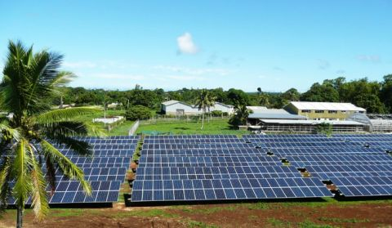
Vava’u, Tonga

Slide 26
RE Project Development Status
Bilateral
NZ bilateral assistance, e.g Tonga Maama Mai in 2012
Japan’s bilateral
China
USA
Aust (Kiribati together with the WB)

Slide 27
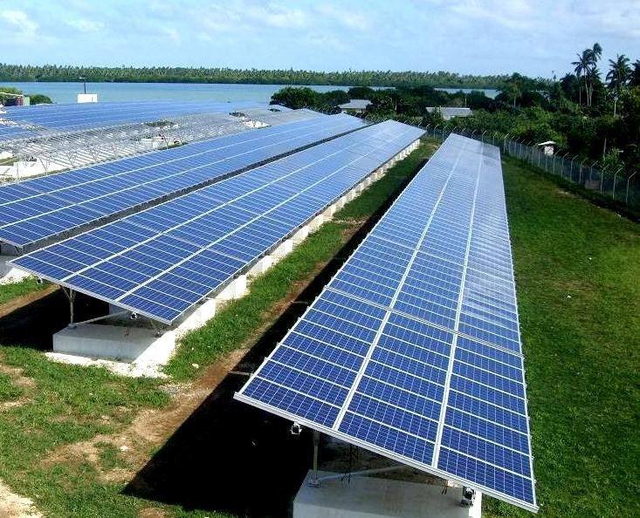
Let There Be Light solar farm - Tonga

Slide 28
Ta’u Island, American Samoa on 100% renewable energy through solar

Slide 30
RE Project Development Status
Other opportunities
GEF 6
GCF
2016 NZ-EU Pacific Energy Conference - investing more than $1 billion by 2024
Renewable electricity in Polynesia rising to 50% or higher
Accelerating access to sustainable energy in Melanesia
Solutions for small islands being applied in Micronesia and elsewhere

Slide 31
Challenges
PICs are capable of developing funding proposals – PEC fund & UAE
Hard to understand the rules of each donor
Hard to understand the donors too, e.g GCF EE Proposal, GEF, etc
Bankable Projects and ideas

Slide 32
RE DEPLOYMENT STATUS

Slide 33
PICs INDC Energy Targets (% of renewable energy in total electricity generation)

Slide 34
Country | INDC targets | Target | Year
Cook Is | 50% islands change from diesel to RE by 2015 to 100% coverage by 2020 | 38% | 2020
Fiji | 100% RE by 2030 from 60% in 2013. Reduce 10% emissions for EE improvements economy wide | 100% | 2030
FSM | Reduce emissions 28% by 2025 below 2000 emissions. Conditional - 35% by 2025 below 2000 emissions | 14.7% | 2025
Kiribati | Reduce emissions 13.7% by 2025 & 12.8% by 2030 | 6.58% | 2025
Nauru | Solar PV installations worth USD 42 million. DSM improvements of USD 8 million. Unconditional - USD 5 million secured for 0.6 MW PV | 50% | 2020
Niue | 38% RE of total generation by 2020 through to 2025. Of this, 10% reduction of electricity demand by 2020. Conditional - 80% RE by 2025 | 38% | 2020
Palau | 45% RE by 2025. 35% EE target by 2025 | 45% | 2025
PNG | 100% RE by 2030 | 100% | 2030
RMI | Reduce emissions 32% below 2010 by 2025. Indicative - reduce emissions to 45% below 2010 levels by 2030 | 55% | 2025
Samoa | 100% RE through to 2025. Conditional - in reaching the target in 2017. | 100% | 2025
Solomon Is | Reduce emissions by 12% below 2015 level by 2025 & 30% below 2015 by 2030. Conditional - reduce 27% by 2025 & 45% by 2030 | 4.68% | 2025
Tonga | 50% RE by 2020. | 50% | 2020
Tuvalu | Reduce emissions from generation by 100% by 2025. | 100% | 2025
Vanuatu | 100% RE by 2030. | 100% | 2030
The varying expressions and target years used in the PICs INDCs.

Slide 35
PICs INDC Energy Targets (% of renewable energy in total electricity generation)

Slide 36
% of the pop. with access to electricity (2012)
SE4ALL global tracking framework
Region | 2010 | 2012
Caucasus and Central Asia | 100 | 100
Developed countries | 100 | 100
Eastern Asia | 98 | 99
Latin America & Caribbean | 95 | 96
Northern Africa | 99 | 100
Oceania | 25 | 29
Southern Asia | 75 | 79
Southeastern Asia | 88 | 90
Sub-Saharan Africa | 32 | 35
Western Asia | 91 | 93
World | 83 | 85

Slide 37
Challenges
Grid stability
Access vs. GHG emission saving
Very much reliant on grant funding
Resilience

Slide 38
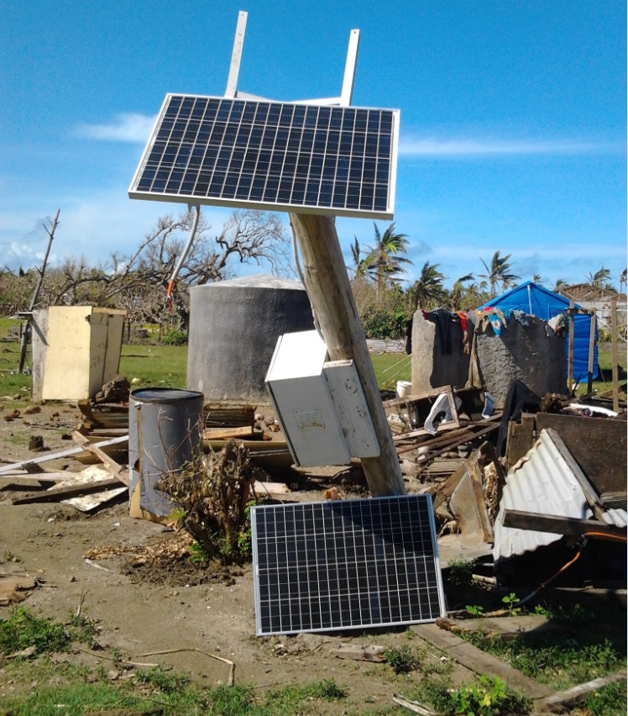
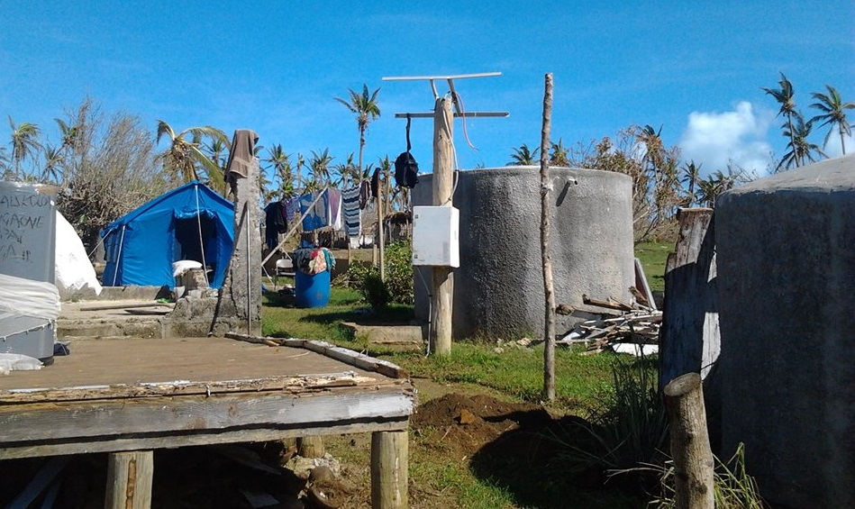
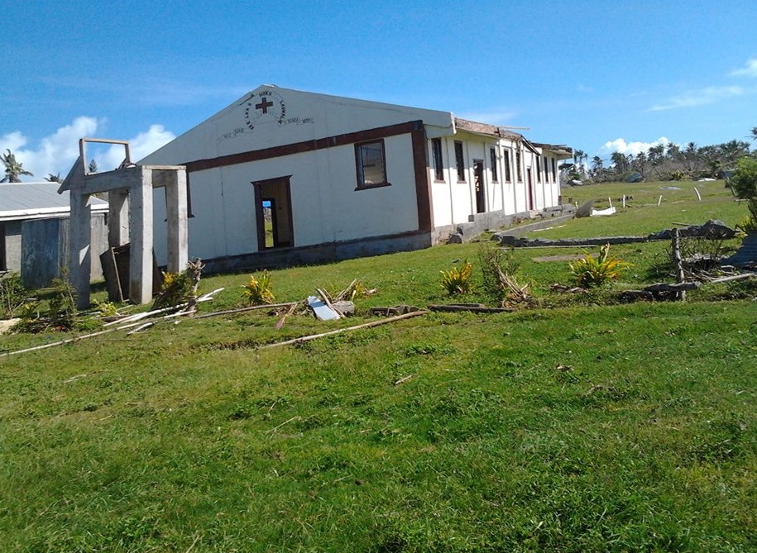
Tonga – Cyclone Ian 2014

Slide 39
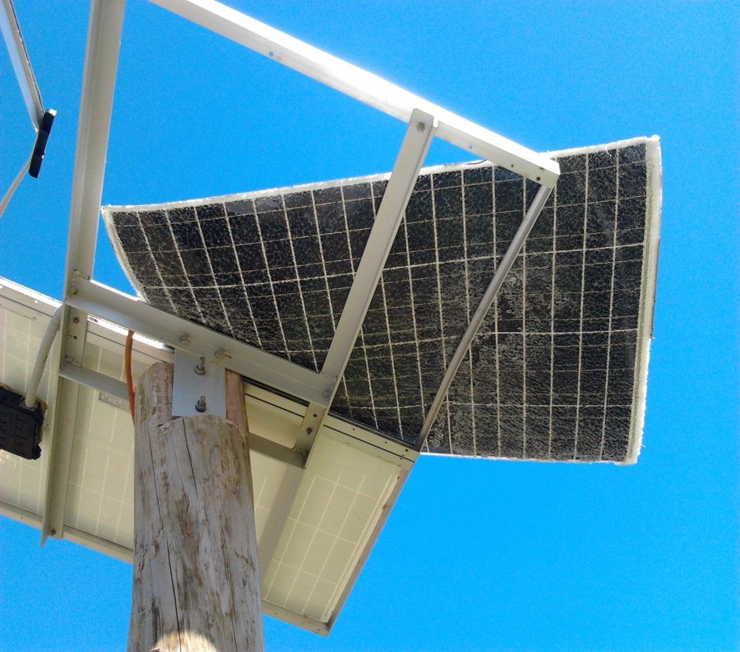
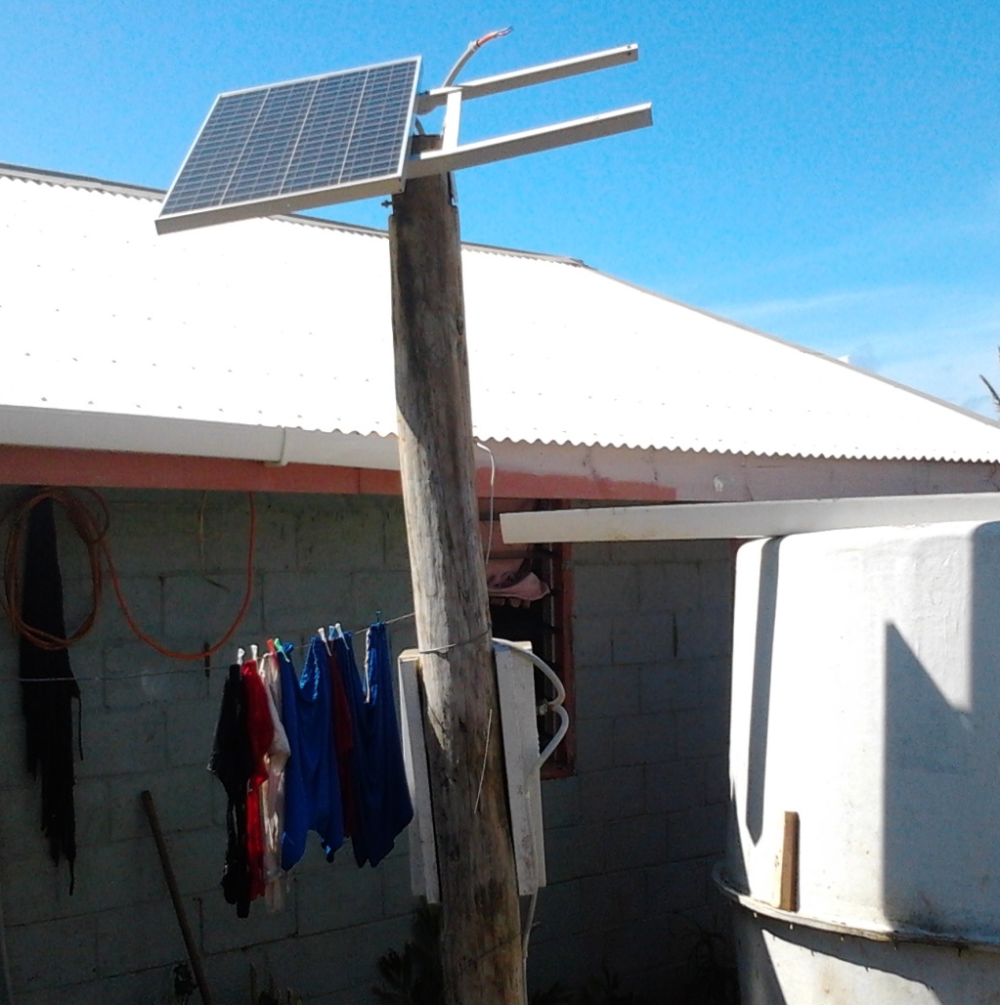
Tonga – Cyclone Ian 2014

Slide 40
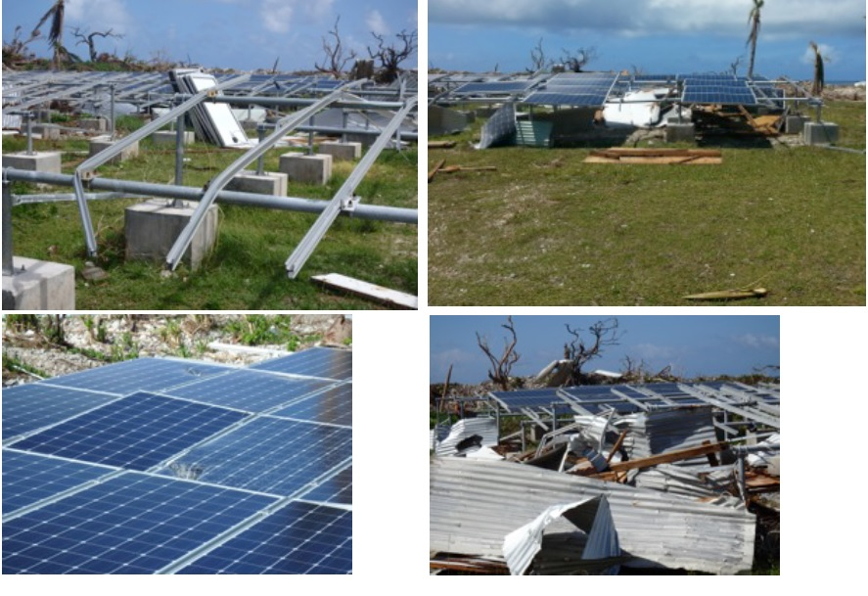
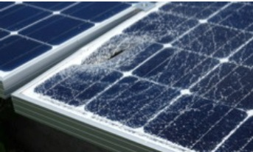
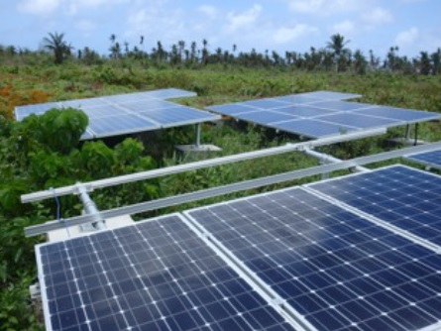
FSM – Cyclone Maysak (2015)

Slide 41
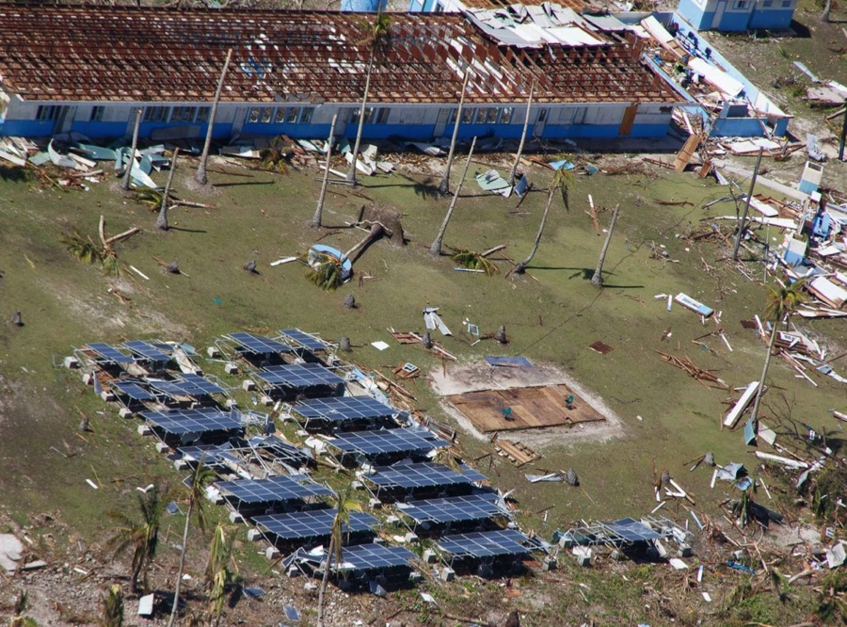
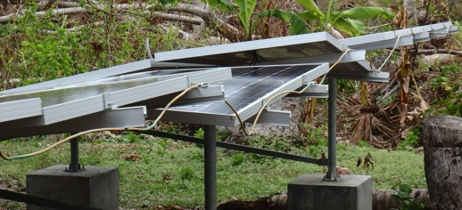
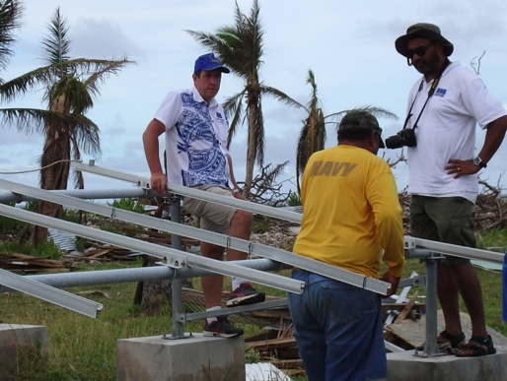
Notes:
What is an energy secure Pacific? Why an energy secure Pacific?

Slide 42
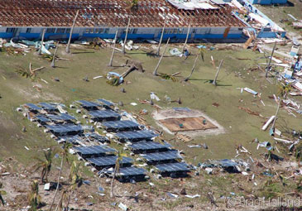

Slide 43
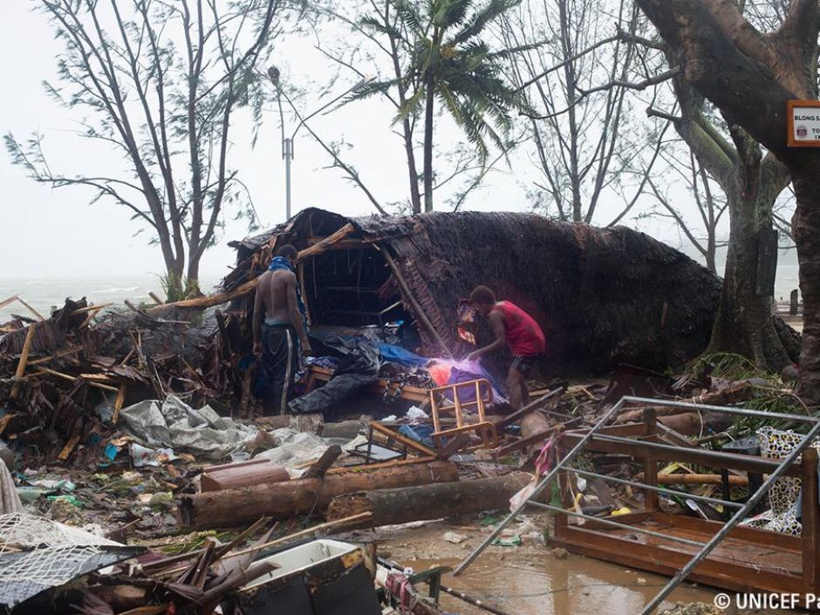
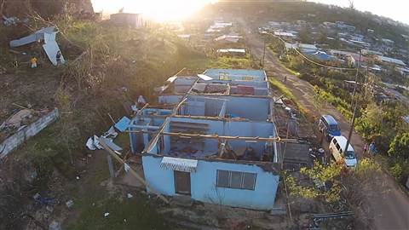
Vanuatu – Cyclone Pam (2015)

Slide 44
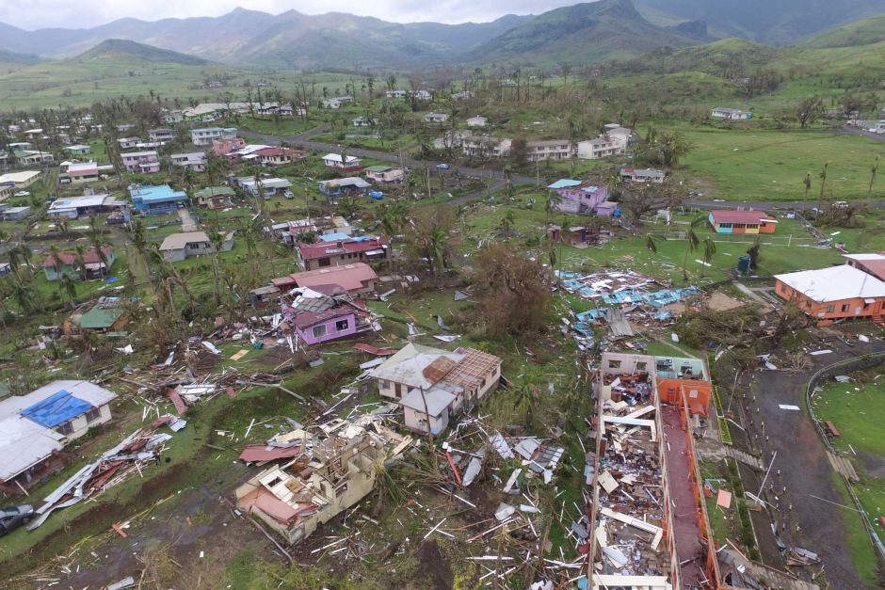
Feb 2016 / TC Winston

Slide 45
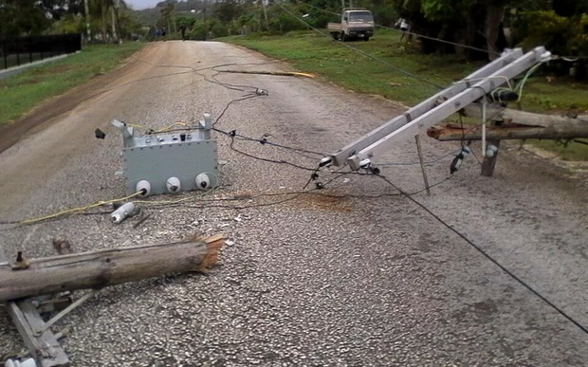
Notes:
2016 Winston Cyclone in Vava’u

Slide 46
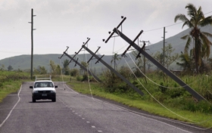
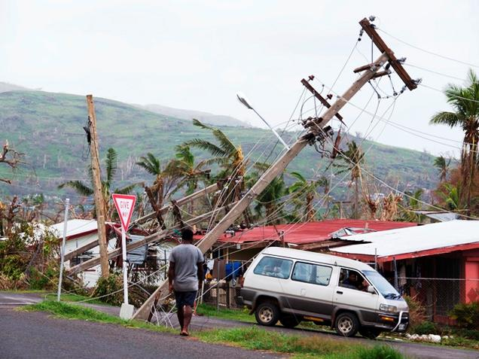
Notes:
24 Feb. 2016 Winston Cyclone at Kings Road, Lautoka, Fiji.
“If you take into account the number of homes all around Fiji that have been damaged or completely demolished, if you look at the impact on agriculture in terms of crops that are on the ground that have been damaged, the ability to plant, ability of people to earn an income and obviously the impact on power lines — you can easily say it is a billion dollar,” (Finance Minister) Sayed-Khaiyum said, according to FBC. (www.ibtimes.com)

Slide 47
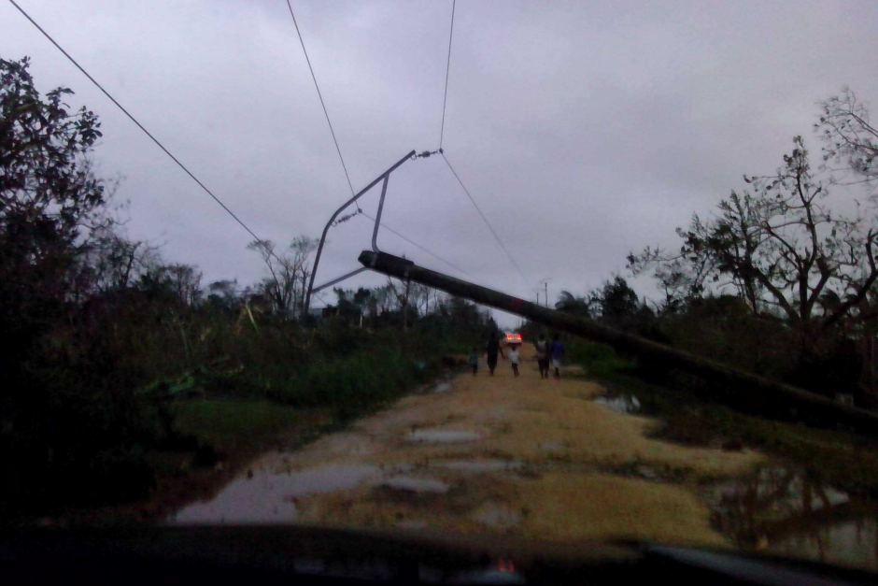
Notes:
Vanuatu 2015 after Cyclone Pam..
A new report estimates the damage at nearly two thirds of Vanuatu's economic output - or nearly $US450 million. (www.abc.net.au)

Slide 48


Different standards

Slide 49


Different Standards

Slide 50

Opportunities - PCREEE

Slide 51


SIDS-SIDS Cooperation / Global Network of Regional Sustainable Energy Centers
UNIDO supports regional organizations and their member states in the creation of regional sustainable energy centers

Slide 52

3rd Floor – PCREEE
2nd Floor – National Emergency Management Office & Dept of Climate Change
1st Floor – Department of Energy & Dept of Communication & Office of the Deputy Prime Minister

