Slide 1
MOEJ’s actions for climate change in SIDS
December 3rd, 2016
Shuichi OZAWA
Ministry of the Environment, Japan (MOEJ)
Notes:
○Thank you, co-organizers and distinguished guests, for inviting me to such a informative and constructive workshop.
○As a co-organizer, I am very pleased to have such many participants here, who are very eager on sustainable energy future in SIDS

Slide 2
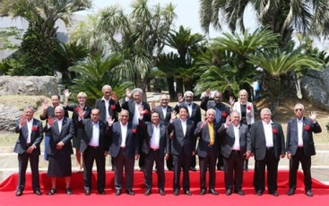
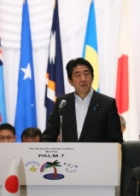
7th Pacific Islands Leaders Meeting (PALM7)
17 countries gathered in May 2015 at Fukushima
Japan committed
550M USD or more in 3 years
Capacity building and exchange of 4000 persons
Leaders’ declaration:
Cooperation with IRENA
Joint Crediting Mechanism (JCM)
Green Climate Fund (GCF)
(Photo: Cabinet Public Relations Office)
Notes:
○ I would like to start my presentation with the revisit of 7th Pacific Islands Leaders Meeting (PALM7) in Fukushima 2015
○Prime Minister Abe announced 550M USD assistance and capacity building and exchange of 4000 persons in his speech
○In Leaders’ declaration, cooperation with IRENA, Japan’s Joint Crediting Mechanism, and role of Green Climate Fund are articulated.
○In response to this and strong global momentum to address energy and climate change, I would like to highlight some MOEJ’s actions for Pacific Islands.

Slide 3
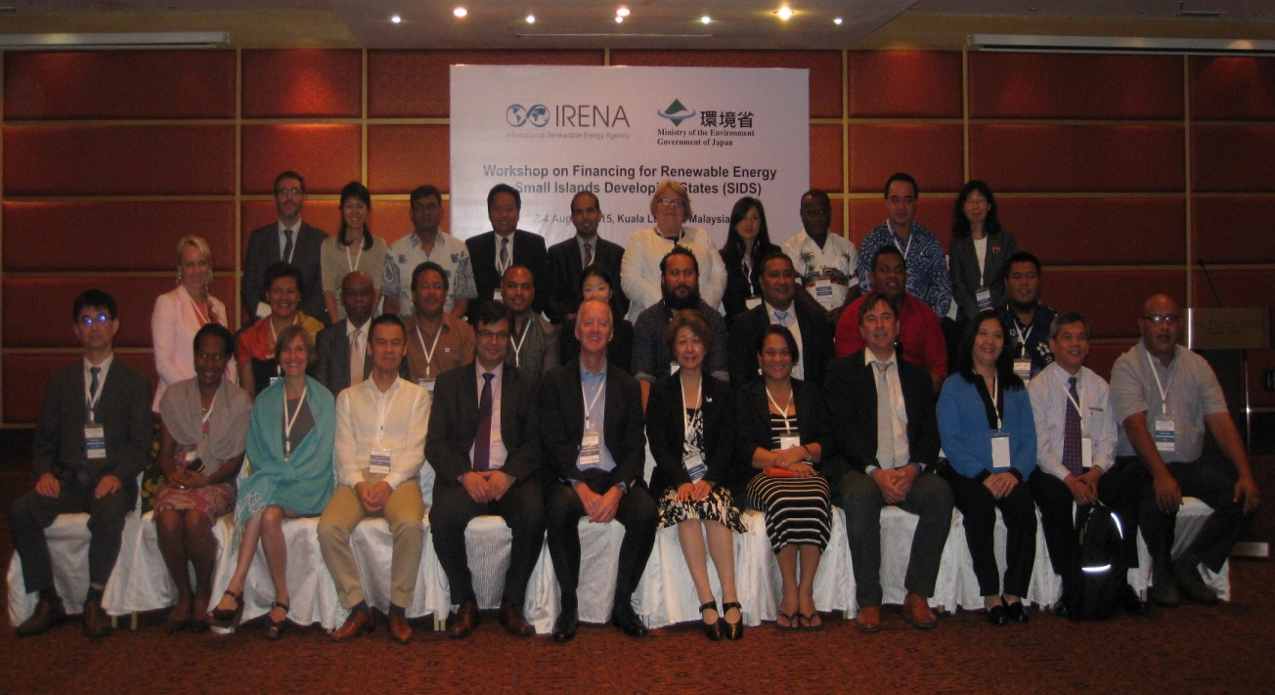
SIDS Finance Workshop with IRENA
Organizers: MOEJ and IRENA
Date and Venue: 3 - 4 August, 2015, Kuala Lumpur, Malaysia
Participants: 21 countries, 5 organizations
Key Focus
Capacity building for local professionals and local financial institutions
Effective facilitation for project development and financing
Financing models and instruments for small-scale RE systems
Notes:
○I would like to introduce MOEJ’s cooperation with IRENA.
○A workshop on financing for renewable energy in Small Island Developing States (SIDS) was jointly organized by MOEJ and IRENA.
○It was held on 3rd and 4th August 2015, in Kula Lumpur, Malaysia, where participants representing 21 countries and 5 organizations attended it.
○Financial aspects of RE projects were intensively discussed. In particular, participants agreed on focusing on three key areas that could make the most impact in SIDS: 1) Capacity building for local professionals and local financial institutions; 2) Effective facilitation for project development and financing; and 3) Financing models and instruments for small-scale RE systems.

Slide 4
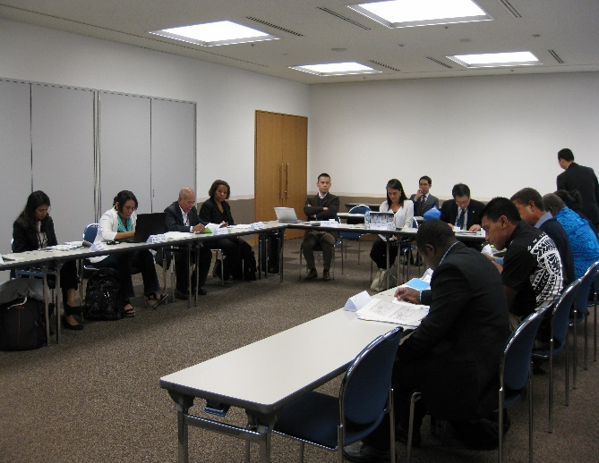
SIDS Training Program with IRENA
Organizers: MOEJ and IRENA
Date and Venue: 8 - 12 February 2016, Tokyo, Japan
Participants: 10 countries, 15 lecturers from Japan and overseas
In-door training sessions and lectures
Site visits
Notes:
○MOEJ and IRENA also collaborated by jointly organizing the training program to support renewable energy deployment in SIDS.
○It was held from 8th to 12th February, 2016 in Tokyo, Japan.
○Representatives from 10 SIDS and 15 lecturers were joined.
○It included in-door training sessions and lectures as well as site visits to Japanese companies with leading low-carbon technologies.
○We believe it provided the good opportunity for participants to exchange knowledge and information on policy, regulatory, institutional and financial aspects for enabling the energy transition to RE in SIDS.

Slide 5
Joint Crediting Mechanism
JAPAN
Partner Countries
Leading low-carbon technologies
Used to achieve Japan’s emission reduction target
GHG emission reductions/ removals
Credits
Operation and management
by Joint Committees
Notes:
○Next is Joint Crediting Mechanism or JCM
○JCM is the bilateral scheme operated by the government of Japan and partner countries, to facilitate deployment of leading low-carbon technologies.
○Under this JCM scheme, Japan will financially and technologically support the installation of advanced low-carbon technologies.
On the other hand, Japan will receive a part of carbon credits.
○ Carbon credits will be used to achieve Japan’s commitment to mitigation actions in developing countries declared in INDC submitted to UNFCCC.
○JCM activities are being operated by the Joint Committee consisting of two countries’ officials.
○As of this moment, there are 16 JCM partner countries including two SIDS: Palau and Maldives.

Slide 6
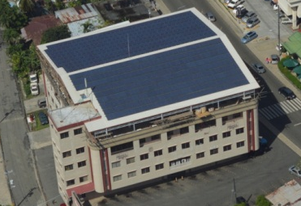
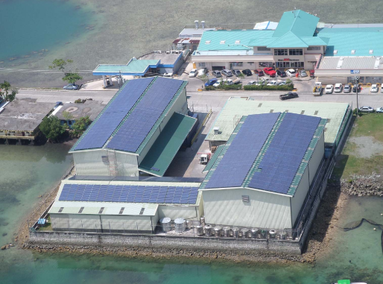
JCM Model Projects in SIDS
Model project program subsidizes up to 50% of initial cost (67M USD budget in FY2015)
4 PV projects adopted in SIDS (3 in Palau, 1 in Maldives)
Solar PV installation on the building roof top
Palau
To be Modified
Country | Title | Capacity | GHG reduction
Palau | Small scale solar power plants for commercial facilities | 370.5KW | 390t/y
Palau | Small-Scale Solar Power Plants for Commercial Facilities Project II | 442KW | 310t/y
Palau | Solar PV System for Schools Project | 150KW | 105t/y
Maldives | Solar Power on Rooftop of School Building | 185KW | 144t/y
Notes:
○ MOEJ’s JCM model project program supports up to 50% of project initial cost to cover the incremental cost of advanced low-carbon technologies.
○ In return for financial support, the project operator needs to conduct JCM project registration, MRV for credit issuance, and delivery of credits to the Japanese government.
○ Although each project scale is relatively small, MOEJ has adopted 3 PV projects in Palau and 1 in Maldives.

Slide 7
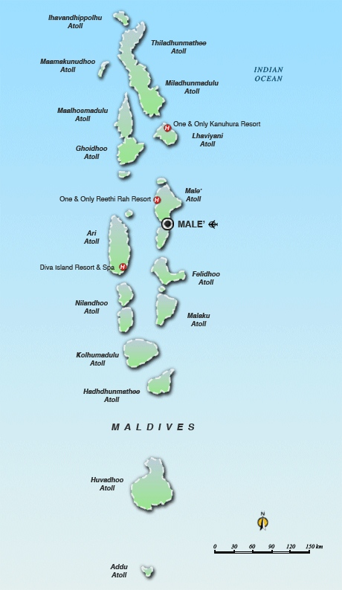
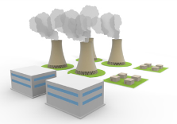
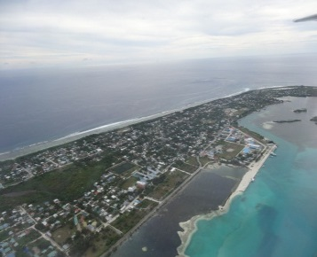
Japan Fund for JCM at ADB
Use of Proceeds
Location (Atolls and Islands)
USD
38MM
PV
ADB Grant
POISED Phase 1
5 islands
Maldives
Khurendhoo
USD
12MM
ADB-administered
Strategic Climate Fund
(CIF SREP)
Goidhoo
Buruni
USD
50MM
Vilingili
European Investment Bank
Addu
Grid
USD
10MM
Diesel
Islamic Development Bank
After Phase 2
Total 160 islands
Improvement of energy efficiency and reduction of energy-derived CO2 emission in Addu
Anticipated additional CO2 emission reduction; approx. 3,000tCO2/year
USD
5MM
Addu
JFJCM
(Japan Fund for JCM)
Addu has a population of over 23,000 inhabitants, the second largest habited island in Maldives.
EMS
Lithium-ion
Battery
*POISED: Preparing Outer Islands for Sustainable Energy Development
6
Notes:
○The other vehicle to promote JCM is Japan Fund for JCM at Asian Development Bank (ADB).
○This fund is our flagship example of collaboration with ADB to mobilize climate finance.
○JFJCM aims to support incremental cost due to the adoption of advanced low-carbon technologies for ADB pipeline projects, with co-financing from ADB’s loan and grant,
occasionally with other multilateral development banks (MDBs) and multilateral funds such as CIF.
○The first approved project is in Maldives to introduce PV generation package in 160 islands.
○Among total cost of 115M USD, JFJCM granted 5M USD to the installation of such advanced EMS and Li-ion battery in Addu atoll to maximize PV power utilization and
optimize existing diesel-power generation.
○3,000t of CO2 emission reduction per year is expected.

Slide 8
More Information on JCM
For more information about JCM, please visit
<Comprehensive Portal to JCM>
http://www.mmechanisms.org/e/index.html
<JCM Model Project Program>
http://gec.jp/jcm/index.html
<ADB Japan Fund for Joint Crediting Mechanism>
https://www.adb.org/site/funds/funds/japan-fund-for-joint-crediting-mechanism
http://www.mmechanisms.org/document/JFJCM_Introduction_English_Upload.pdf
7
Notes:
○Today, I introduced only a portion of JCM activities.
○Abundant information is available on-line in English.
○I recommend the websites on this slide for your further information.
○Also, if you contact me directly, I will be happy to respond to your questions.

Slide 9
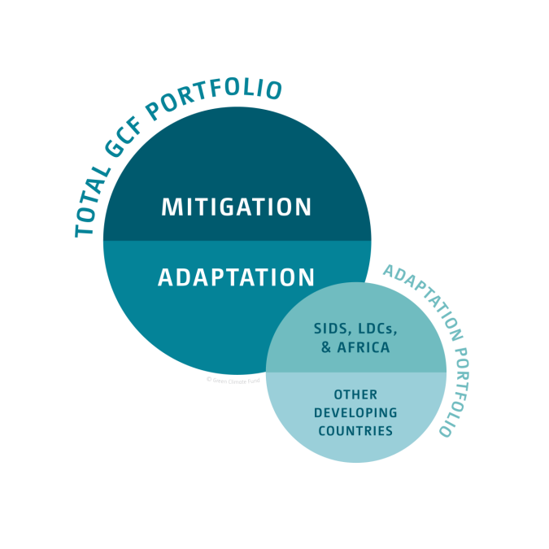
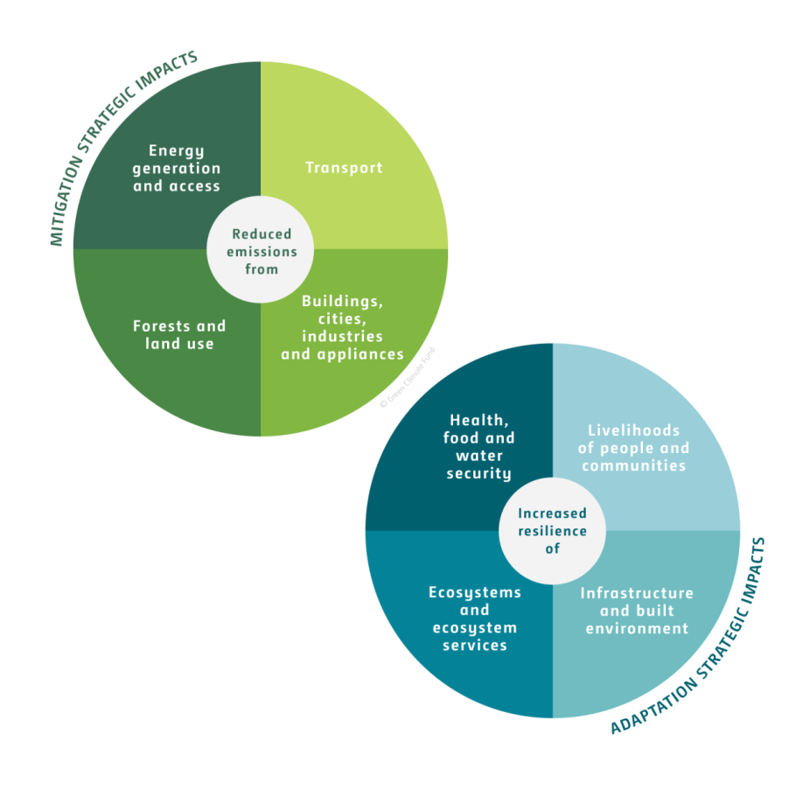
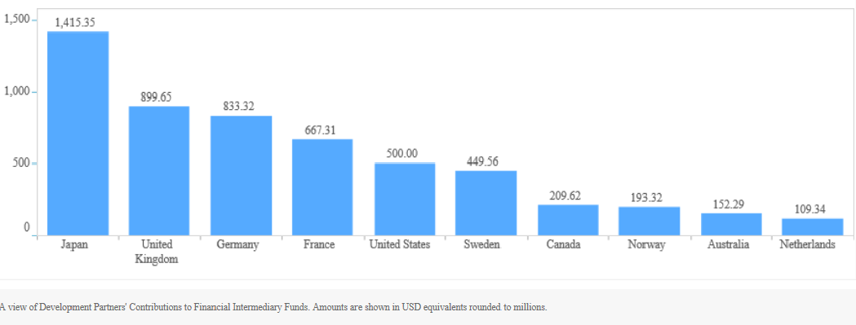
Japan’s Commitment to GCF
Particular focus on SIDS and transforming energy generation and access
Japan as the second largest contribution at 1.5B USD, and actively involved in fund management, readiness support
4 out of total 27 approved projects are in SIDS such as Fiji, Maldives, Tuvalu, and Eastern Caribbean.
Source: http://www.greenclimate.fund/newsroom/infographics
Project | GCF Contribution | Accredited Entity
Tuvalu Coastal Adaptation Project | USD 36.0 m | UNDP
Fiji Urban Water Supply and Wastewater Management Project | USD 31.0 m | ADB
Support of Vulnerable Communities in Maldives to Manage Climate Change-Induced Water Shortages | USD 23.6 m | UNDP
Sustainable Energy Facility for the Eastern Caribbean | USD 80.0m | IDB
Category | Project | Beneficiaries | GCF contribution | Approved date | Accredited Entity
Adaptation | Tuvalu Coastal Adaptation Project | 6599 people | USD 36.0 m | June 2016 | UNDP
Adaptation | Fiji Urban Water Supply and Wastewater Management Project | 290,854 people | USD 31.0 m | November 2015 | ADB
Adaptation | Support of Vulnerable Communities in Maldives to Manage Climate Change-Induced Water Shortages | 295,000 people | USD 23.6 m | November 2015 | UNDP
Source: http://fiftrustee.worldbank.org/Pages/gcf.aspx
Geothermal Energy
Notes:
○I would like to move to Green Climate Fund or GCF.
○GCF was established under the UNFCCC in 2011 and aims to equally balance its allocation between adaptation and mitigation over time.
○It will also aim to allocate at least half of its resources for adaptation for countries, with a particular emphasis on vulnerable countries including SIDS and LDCs.
○Japan has offered to contribute the second largest amount to the GCF: $1.5 billion.
○Japan also has been currently supporting he development of a draft of the guidebook of the GCF Readiness and Preparatory Support Programme. We expect that it will be finalized and ready very soon for developing countries to enhance country ownership and access to the Fund.
○For individual projects, 27 projects have been already approved, among which are 4 SIDS projects in Fuji, Maldives, Tuvalu and Eastern Caribbean.
○We, as a fund contributor, are expecting that more RE projects in SIDS will come out in the near future.
<GEF>
○Global Environment Facility (GEF) is also ramping up its investments in renewable energy for SIDS, and reiterating its commitment to support SIDS in this crucial sustainable development priority.
○The total country allocations of SIDS in GEF-6 amount to US$256 million, equivalent to an increase of 9% compared to GEF-5.

Slide 10
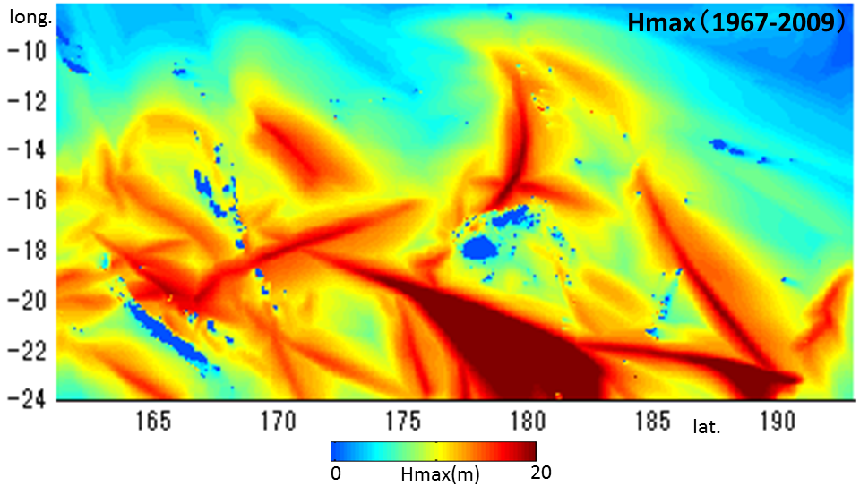
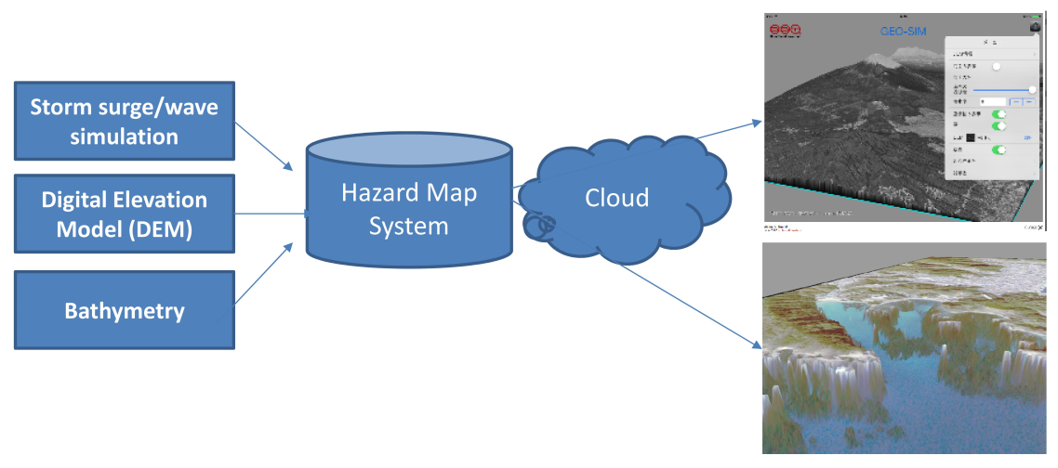
Impact Assessment of Climate Change in SIDS
Evaluate impacts of storm surge/storm wave hazards in Fiji, Vanuatu, Samoa with to develop hazard map system.
Assessing the hazard of storm surge/ storm with Ministry of Economy, USP and SPC.
Developing networks in South-Pacific with SPREP
Notes:
○Let me introduce a bit about two adaptation support to SIDS by MOEJ.
○MOEJ has been conducting research project with Fiji, Vanuatu, and Samoa to evaluate impacts of storm surge/storm wave hazards to develop hazard map.
○The project assesses the hazard of storm surge/storm tide considering the historical event and applying the climate change scenario
in cooperation with the governments, USP and SPC.
○In addition, the networks in South-Pacific to disseminate the methodology is being developed in cooperation with SPREP.

Slide 11
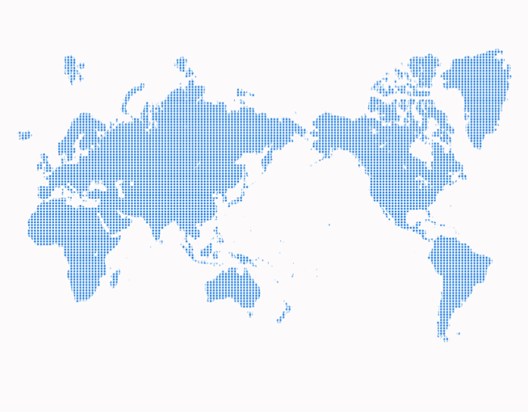
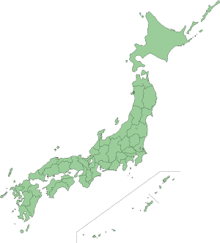
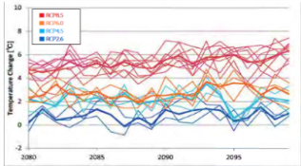
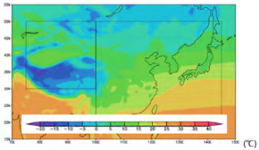
Asia-Pacific Adaptation Information Platform
Will be established by 2020 to share climate risk information online
Based on Japan’s A-PLAT starting its operation in Aug 2016
Support adaptation measures by providing advanced scientific climate risk information
Japan takes a lead in dataset for projection, toolkits for policymakers and stakeholders,
and capacity building
Calling for participation from the countries in Asia Pacific and other Regions
Japan
A-PLAT
Scaling up to
Asia-Pacific Region by 2020
Local Government
Ministries/Agencies
Research institutions
Developing countries
Cooperation
A-PLAT
Secretariat
(NIES)
Developing countries
Developing countries
Developing countries
Private Sector
Cooperation
Universities
Notes:
○The other is the establishment of Asia-Pacific Adaptation Information Platform. ○As I explained the other slide, now we are conducting impact assessment of climate change in SIDS in the areas of storm surge/storm wave. ○We would like to widely share this kind of scientific data and information through this platform.
○This network is scheduled to be established by 2020 share climate risk information online with research/academic institutions multi-nationally.
○The prototype of this network is Japan’s domestic platform (A-PLAT) established this August.
○The network will contribute to planning adaptation measures by providing climate risk information and Japan will take a leading-role for its initiation including dataset for projection, toolkits for policymakers and stakeholders, and capacity building.
○We are now soliciting participation of Asia-Pacific countries, and even countries from other regions.

Slide 12
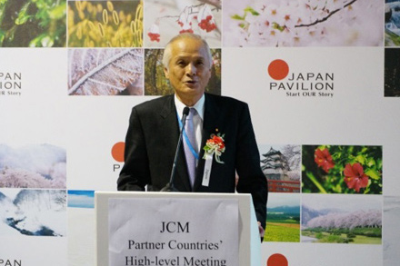
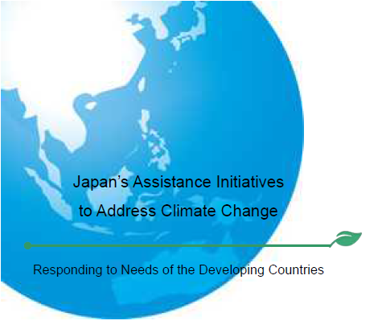
Japan’s Initiative at COP22
“Japan’s Assistance Initiative to Address Climate Change” was released at COP22
Support for RE deployment including JICA, JCM schemes
Establishment of Asia-Pacific Adaptation Information Platform
MRV and F-gas capacity buildingc
Available at http://www.env.go.jp/en/headline/2277.html
11
Notes:
○Finally, I would like to briefly introduce “Japan’s Assistance Initiative to Address Climate Change”
○It was released at COP22 to declare Japan’s further commitment to international cooperation for climate change.
○It includes RE deployment support such as JICA, JCM, Establishment of Asia-Pacific Adaptation Information Platform, and MRV and F-gas capacity
building.
○I brought copies of flyers and booklet introducing this initiative. Please feel free to pick it up.

Slide 13
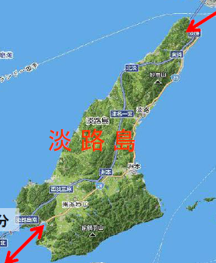
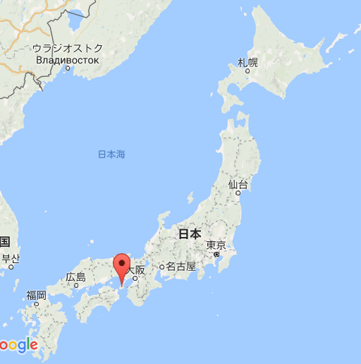
Way Forward (1)
2nd RE Training Program for SIDS with IRENA
Date: 6-10 Feb. 2017
Place: Tokyo, Kobe
RE policy Lecture from central and local governments
Site visit to renewable facilities in Awaji island
Asia-Pacific SIDS countries will be invited
Notes:
○As for Way Forward, Let me mention that MOEJ and IRENA will organize 2nd RE training program for SIDS officials in coming February.
○It is scheduled on 6 to 10 February, 2017, in Tokyo and Kobe Japan. Asia-Pacific SIDS officials are expected to be invited.
○This time, we will make a site visit to Awaji island adjacent to Kobe where many RE projects are implemented towards the ultimate goal of 100% RE energy in 2050.

Slide 14
Way Forward (2)
Hold step-by-step financial proposal training focusing on GCF
(Dec 12 to 16, by AIT)
Finalize the textbook concisely summarizing ADB, GEF, CIF, and GCF mitigation funding scheme

Slide 15
Thank you for your attention !
Notes:
○Thank you for your attention to my presentation.
○ If you have any questions on my presentations, I am more than happy to respond after this session is finished.

