Slide 1
Beyond Traditional Way of Financing Sustainable Energy Financing Project – a case study
Kamleshwar Khelawan, Senior Energy Specialist,
The World Bank, December 2016

Slide 2
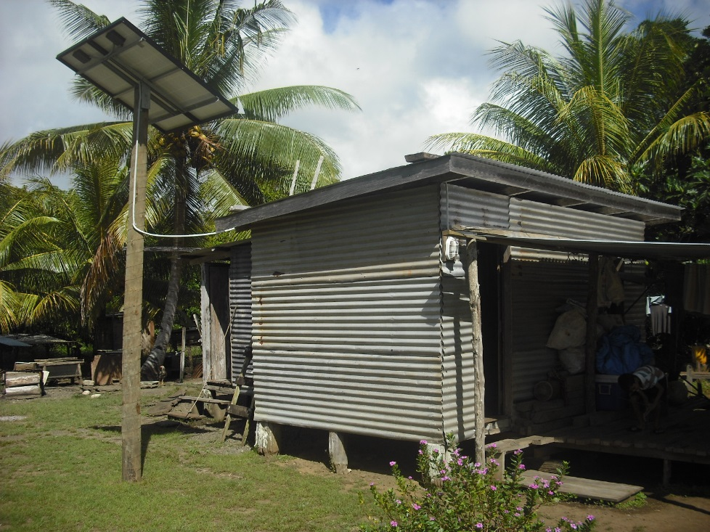
Benefits of a risk sharing facility
Mobilize additional finance – development partner, government constraints
Achieve a “multiplier-effect” – large investment at low costs
Address risk associated with new technologies
Promote private sector participation
Encourage innovation* – demand driven, instead of supply-side, public sector led investments
Achieve sustainability by stimulating demand and promoting business development
Photos: Courtesy DoE, Fiji

Slide 3
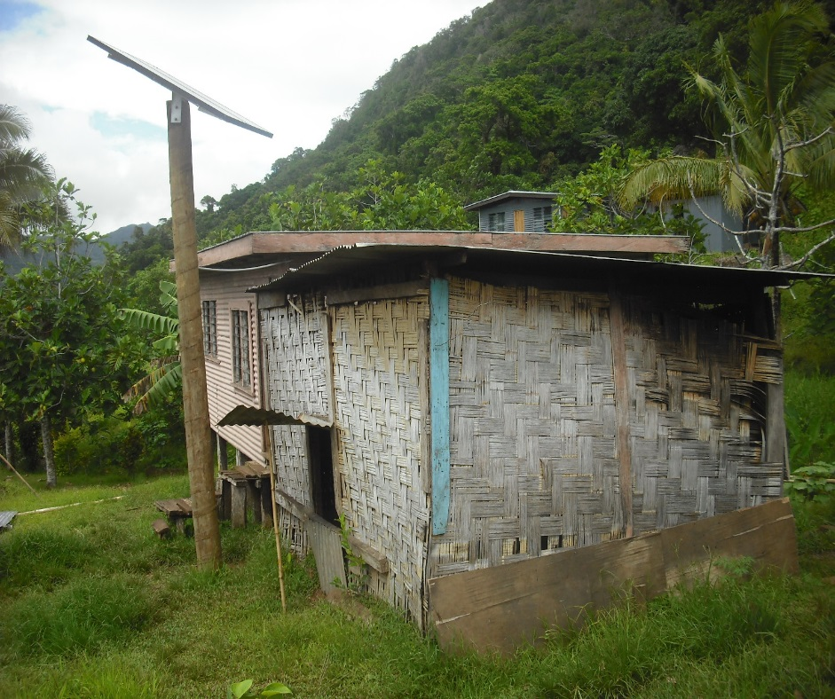
Sustainable Energy Financing Project A case study
A risk share facility
Encourage commercial banks lending to individuals and businesses for renewable energy and energy efficiency
Guarantees 50% of the loan issued
Introduced when renewable energy technology was new and relatively expensive
Photos: Courtesy DoE, Fiji

Slide 4
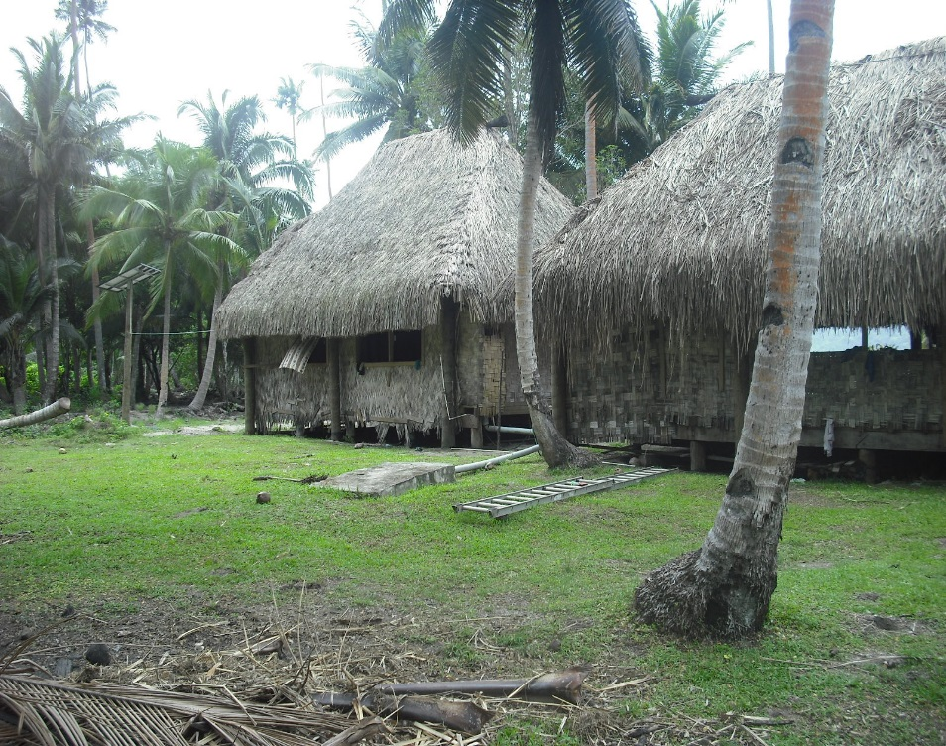
Sustainable Energy Financing Project
Global Environment Facility/World Bank grant
Since July 2007, closes on December 2017.
Originally launched in Fiji, Papua New Guinea and Solomon Islands as a regional project.
Restructured in 2014 to consolidate operations in Fiji.
Photos: Courtesy DoE, Fiji

Slide 5
SEFP – objectives and operation
Objective: to increase the adoption and use of renewable energy technologies and more efficient use of energy through incentives to encourage lending by local financial institutions (commercial banks).
A US$5.2M Risk Sharing Facility (RSF) administered by the ANZ Bank (Fund Manager).
$US2.5M Technical Assistance facility through the Department of Energy, Fiji to promote and implement the SEFP – including resources studies, legal, regulatory, demos and other.
ANZ Bank, Fiji Development Bank (FDB) and Home Finance Corporation (HFC) current Participating Financial Institutions (Lenders).

Slide 6
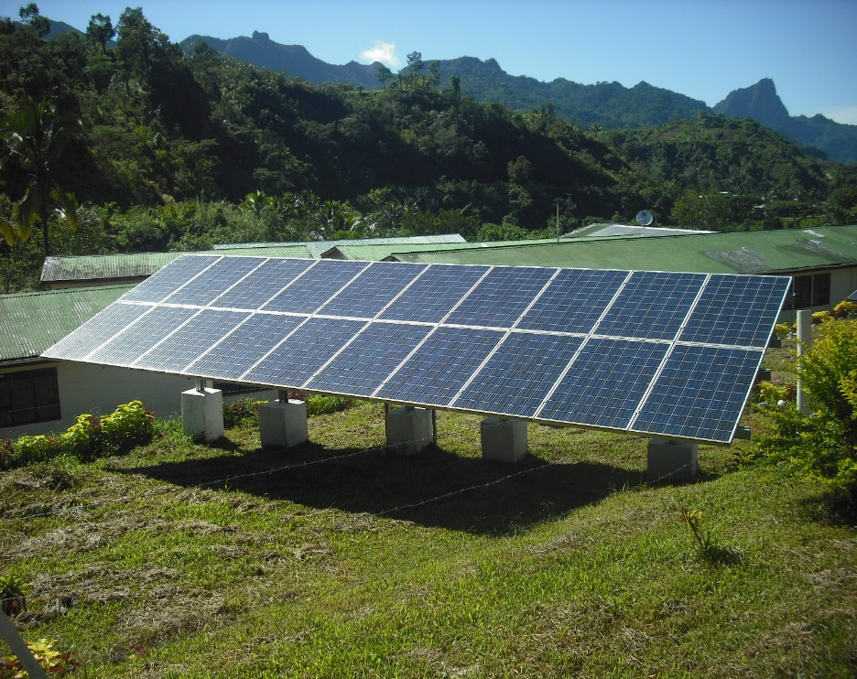
SEFP – technology supported
Solar photovoltaic.
Pico hydro (small hydro systems)
Coconut oil (new and switching) and associated equipment
Other renewable energy products e.g. solar hot water
Energy efficiency equipment
Photos: Courtesy DoE, Fiji

Slide 7
SEFP – performance
US$21.5M in loans for renewable energy and energy efficiency equipment (over US$40M total investment)
4.3MW of renewable energy benefiting over 100,000 people and communities (+ 0.4MW energy efficiency)
More than 13,500 units of >10W solar units and over 31,000 units of <10W solar units
11 biofuel generators and 1 biofuel mill
Around FJ$1.5M in Technical Assistance since 2007

Slide 8
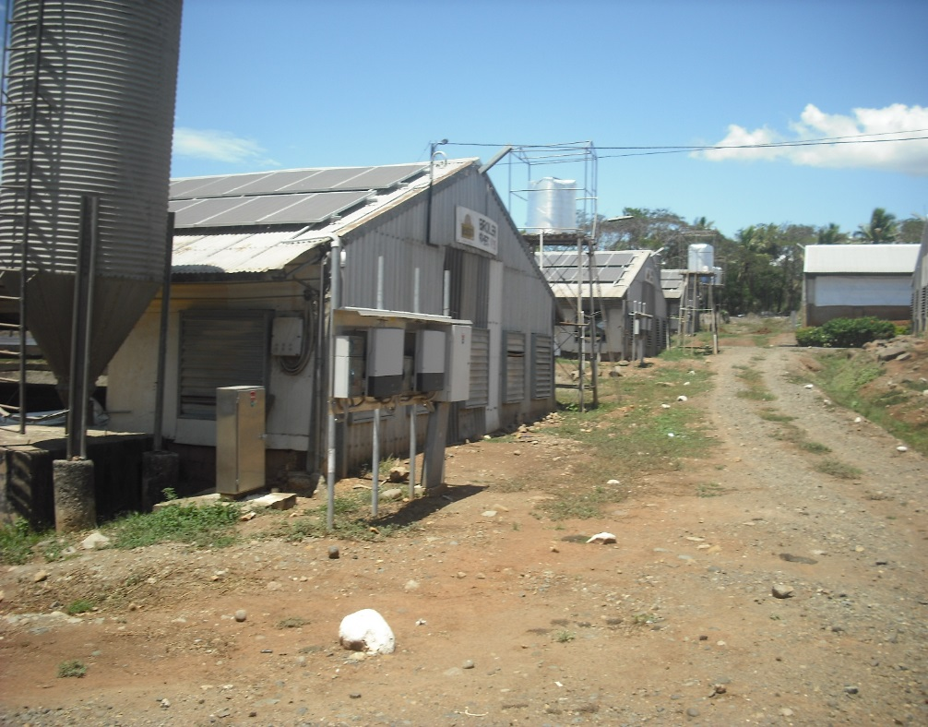
SEFP – contribution
Knowledge and capacity building - renewable energy and energy efficiency - policies, regulation, technology, standards and financing
Community and user awareness on products, their applications and operations
Competition in the supply of renewable energy and efficiency equipment
Photos: Courtesy DoE, Fiji

Slide 9
SEFP Lessons (criteria for success)
Strong capacity in Implementing Agency
Supportive policy, legal and regulatory framework e.g. Reserve Bank of Fiji policy to hold % of portfolio in RE
Lending to both suppliers and end-users (investors) – for working capital and financing
Competition amongst lenders/commercial banks
Need to address individuals access to finance – constraints = credit history and seasonable incomes

Slide 10
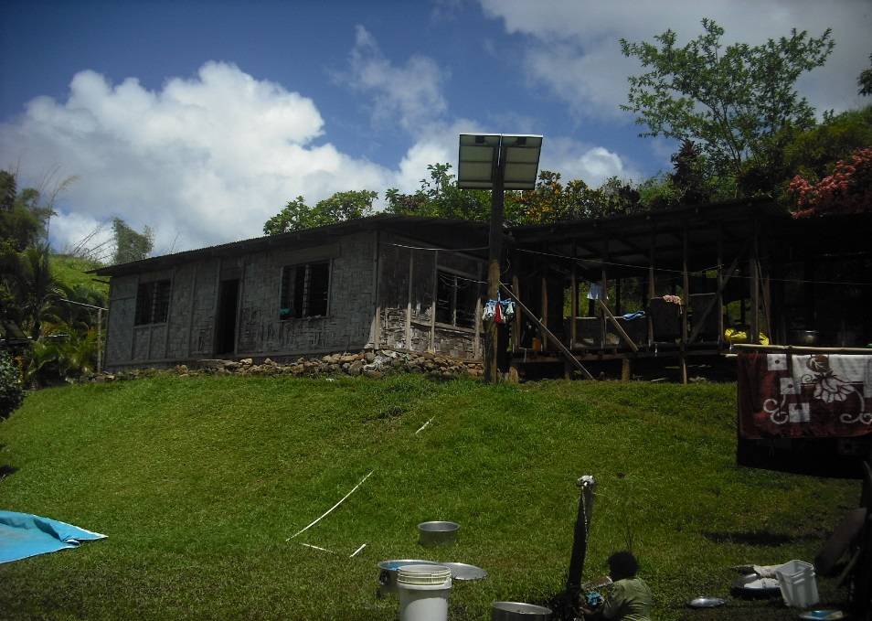
Mid Term Review
RSF successful - indicators achieved
Banks, retailers and end-users satisfied with SEFP
Banks would not have lent without the RSF – estimate ongoing demand of > US$40-$50M in Fiji, not averse to paying a guarantee fee. Demand in other PICs
Retailers see a continued need for RSF support
Lending to individual borrowers less successful
Photos: Courtesy DoE, Fiji

Slide 11
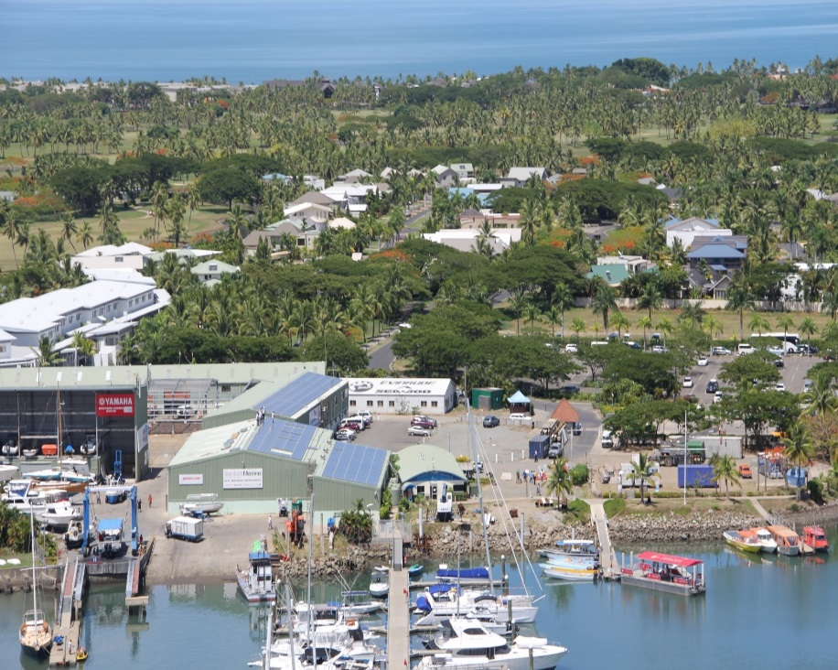
SEFP – options for future
Close the SEFP after 10 years of operation
Relaunch Regional Risk Facility to leverage lessons from Fiji
Fiji, Vanuatu and potentially others
Potentially a partial fee based facility (with WB/IBRD or IFC collaboration)
Photos: Courtesy DoE, Fiji

Slide 12
Thank you

