Slide 1
Just Transition and Skills Requirements
Coal Regions in Transition: investing in renewables
Brussels, 7 JUNE 2018
EU Sustainability Week (EUSEW)

Slide 2
Reduction in Energy-related CO₂ under REmap
Renewable energy and energy efficiency can provide over 90% of the reduction in energy-related CO₂
Annual energy-related CO₂ emissions and reductions, 2015-2050
An upper limit of 2 degrees with a 2/3 chance of success:
790 Gt energy CO₂ emissions budget 2015-2100
Source: IRENA, 2018
Annual energy-related emissions are expected to remain flat (under current policies in the Reference Case) but must be reduced by over 70% to bring temperature rise to below the 2°C goal. Renewable energy and energy efficiency measures provide over 90% of the reduction required.

Slide 3
Energy Sector and Socio-economic System Transition
Source: IRENA, 2018
A true and complete transition includes changes in the energy sector and the broader socio-economic system, and their interlinkages.

Slide 4
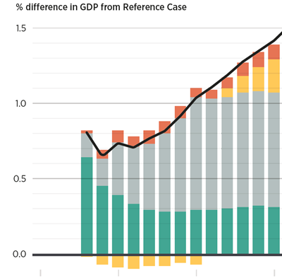
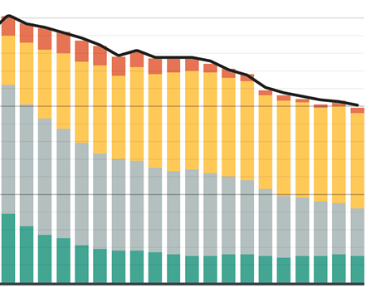
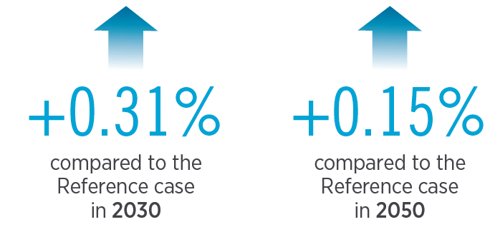
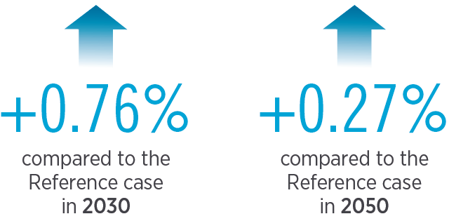
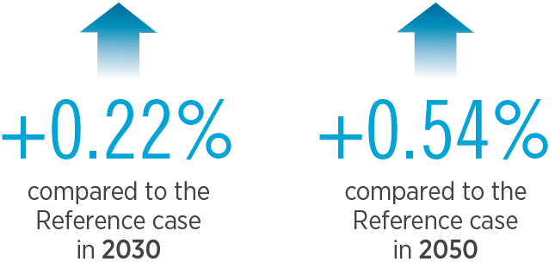
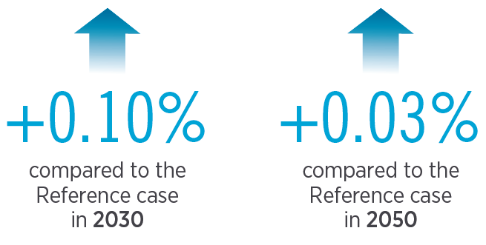
Socio-economic Benefits of the Energy Transition
+ 1.0 %
+ 0.14 %
+ 15 %
+ 2.06
USD trillion
+ 11 million
in the energy sector
Jobs
Investment
Tax rate
Indirect and induced
Trade
Source: IRENA, 2018

Slide 5
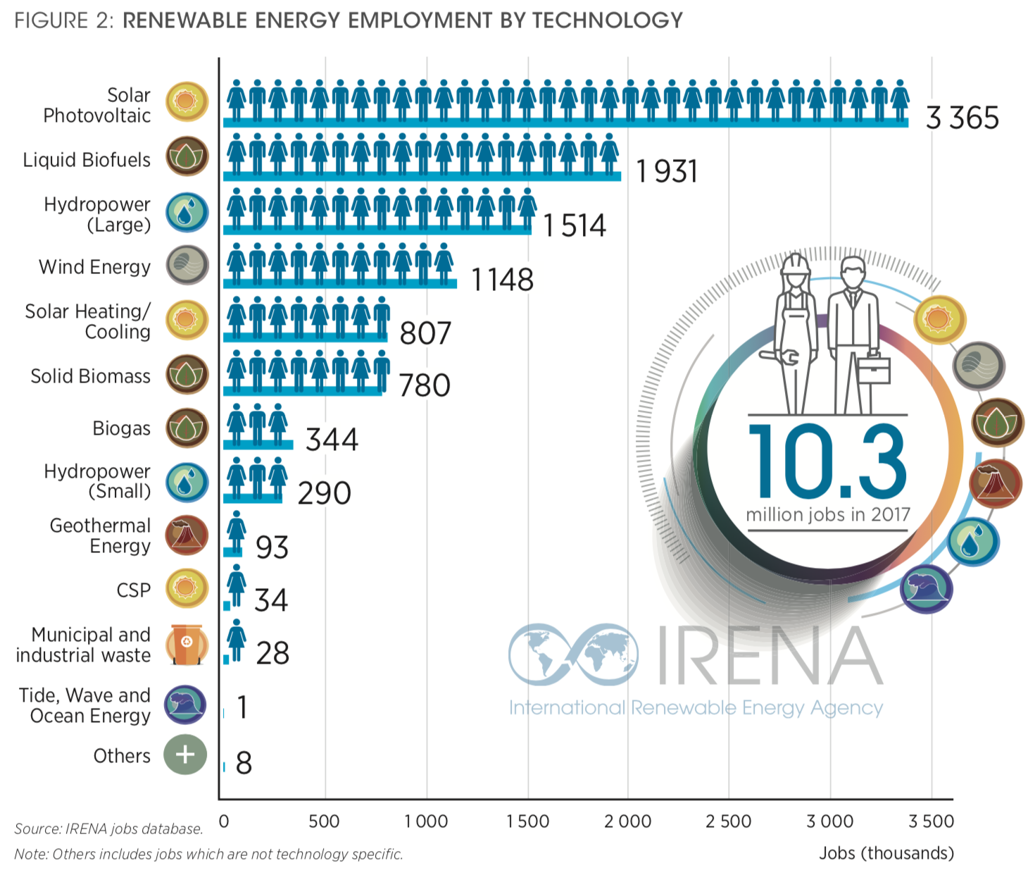
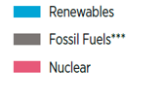
Energy Jobs Today
41
10.3
2017
Source: IRENA, 2018

Slide 6
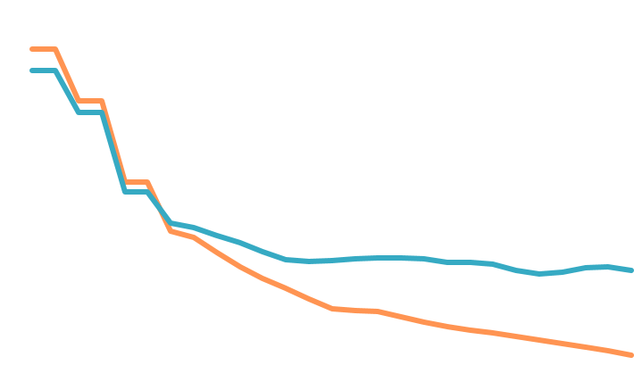
Job Loss in the Coal Sector
Coal Production and Employment in the United States, 1985-2016
Selected countries:
Million Short Tons of Coal
Thousands of Jobs
70% job loss in 3 decades
Source: Federal Reserve Bank of St. Louis, 2016; Energy Information Administration Monghly Energy Review ,2016
90% jobs loss in 3 decades
Coal Production and Employment in Germany, 1985-2012
Million Tons of Coal
Thousands of Jobs
Plans to close 5,600 coal mines
Loss of 1.3 million jobs expected
Source : Statistik der Kohlenwirtschaft

Slide 7
Energy Jobs by 2050
54.3 million jobs in non-fossil fuels, non-nuclear
Fossil fuels: loss of 8.6 million jobs by 2050 compared to today’s 30 million.
Source: IRENA, 2018

Slide 8
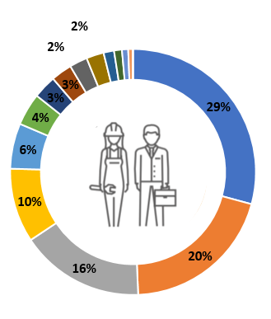
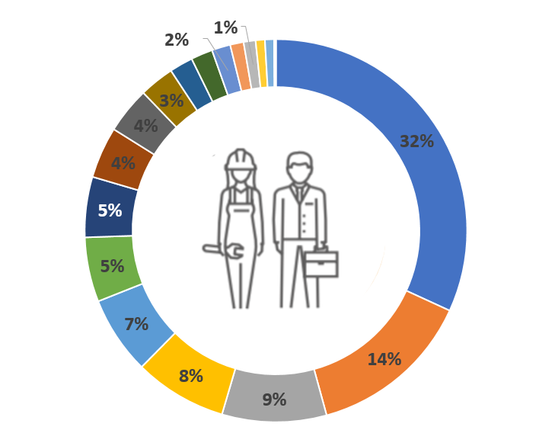
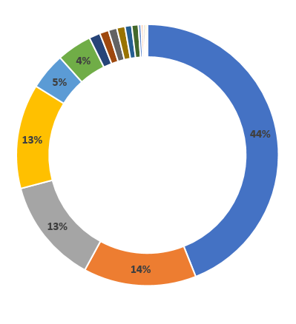
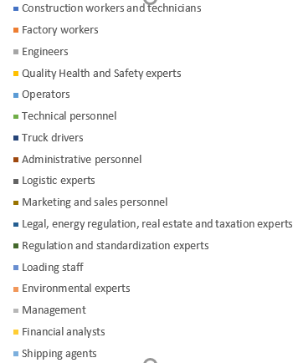
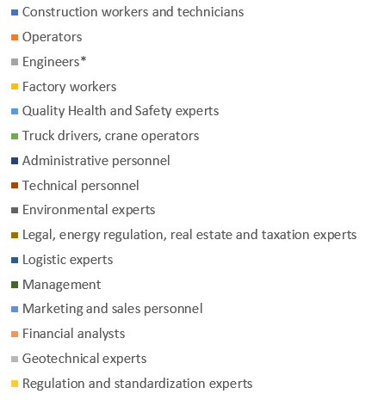
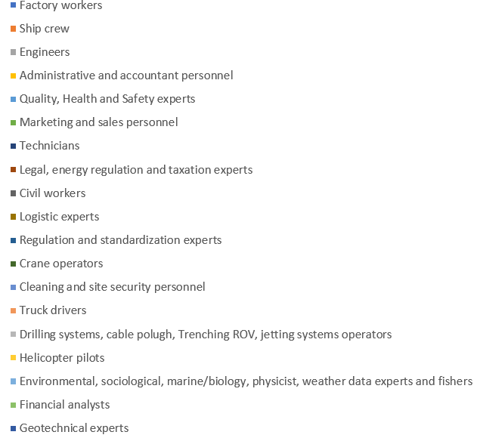
Occupational Profiles
50 MW solar PV
229 055 person-days
50 MW onshore
144 420 person-days
500 MW offshore
2.1 million person-days

Slide 9
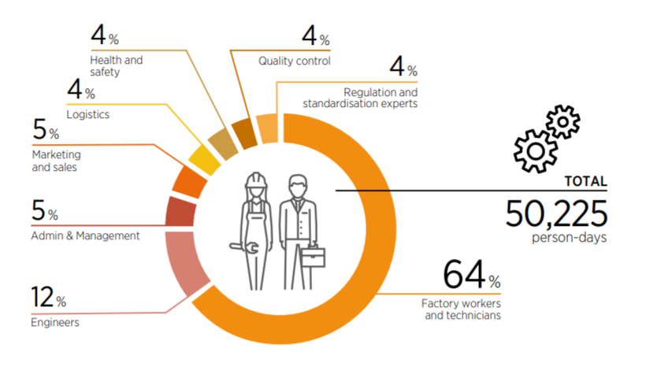
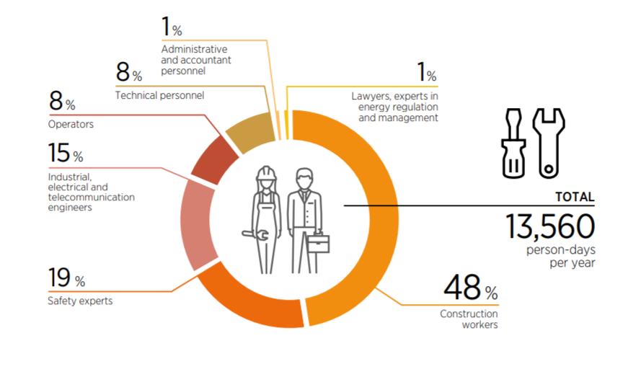
Solar PV
50 MW solar PV: 229 055 person-days
Source: IRENA, 2017

Slide 10
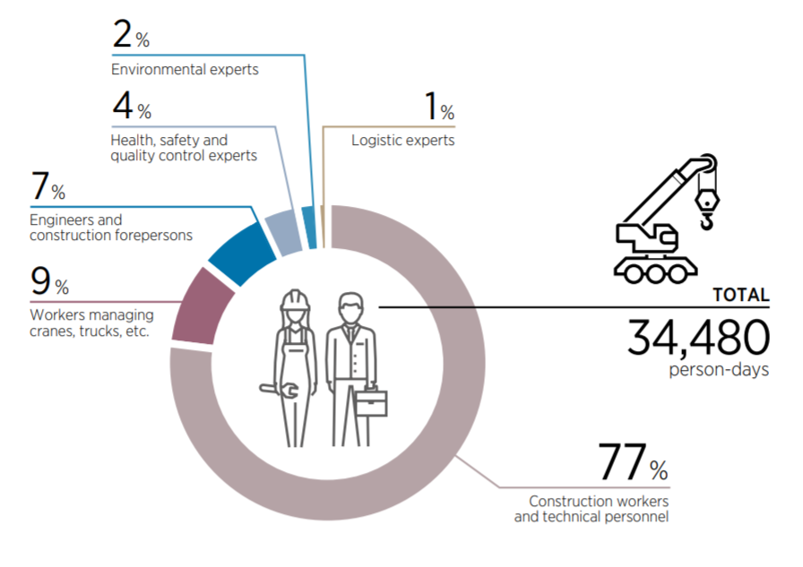
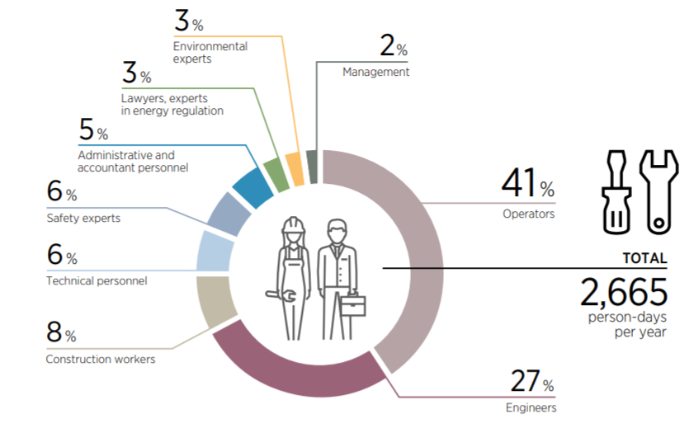
Onshore Wind
50 MW onshore wind: 144 420 person-days
Source: IRENA, 2017

Slide 11
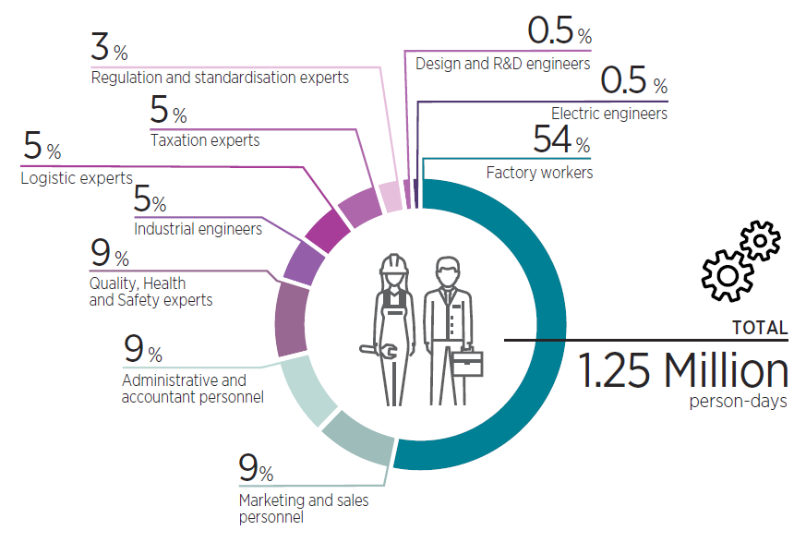
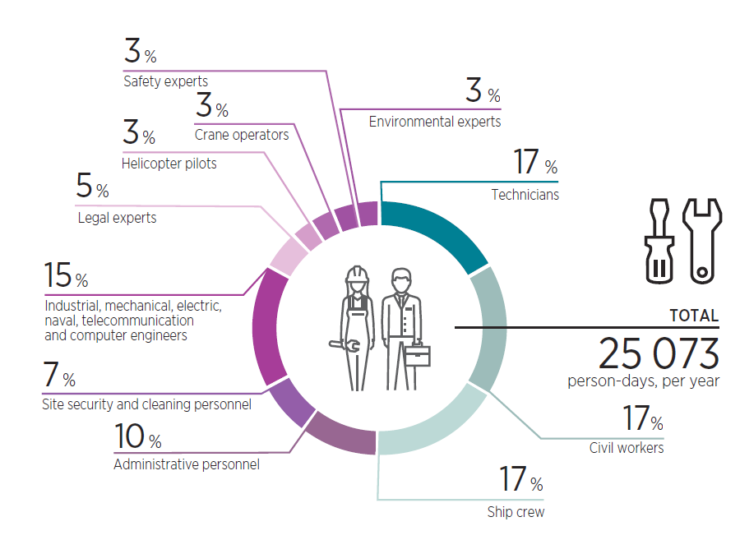
Offshore Wind
500 MW offshore wind: 2.1 million person-days
0.3%
0.1%
Source: IRENA, 2018

Slide 12
Adjustment Programmes
Examine skills and occupational profiles in rising and declining industries
Assess the need for reskilling and establish retraining programmes
Strengthen social protection measures (unemployment insurance, early retirement…)
Offer relocation assistance to bridge any mismatch between where jobs are lost and gained
Support technology development and business incubation as part of economic diversification

Slide 13
Priority Actions
Analyse labour, materials and equipment needs along the supply chain
Leverage existing capacities in support of value chain development
Assess skills needs and coordinate education and training policies with the needs of the RE sector
Design industrial policies to strengthen the capability of domestic value creation
Reinforce deployment policies

Slide 14
To know more about the Global Energy Transformation, this and other IRENA publications are available for download from www.irena.org/publications
For further information or to provide feedback, please contact IRENA at info@irena.org
For further information or to provide feedback on the socio-economic analysis please contact the Policy team at policy@irena.org, on the REmap analysis please contact the REmap team at remap@irena.org.
^{www.irena.org}
^{www.instagram.com/irenaimages}
^{www.twitter.com/irena}
www.flickr.com/photos/irenaimages
^{www.facebook.com/irena.org}
^{www.youtube.com/user/irenaorg}
Copyright © IRENA 2018
Unless otherwise indicated, material in this slide deck may be used freely, shared or reprinted, so long as IRENA is acknowledged as the source.

Slide 15
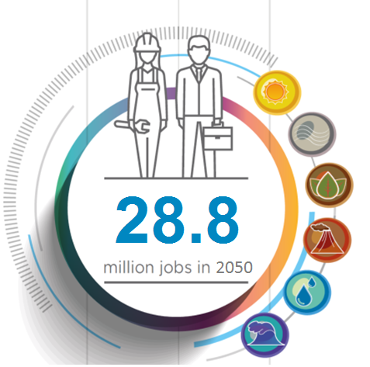
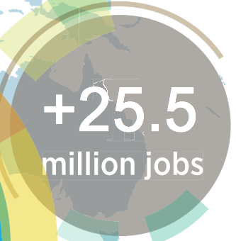
Renewable energy jobs
Losses in fossil fuels
Oil and Gas: (2015-2016)
440,000 jobs lost globally
Coal:
In energy efficiency
and grid enhancement
70% jobs decline in 3 decades
90% jobs decline in 3 decades
Plans to close 5,600 coal mines - 1.3 million job losses
Fossil fuel sector is estimated to lose 7.4 million jobs in 2050.
Jobs in renewables are estimated to grow to 28.8 million in 2050.

